Slide 1
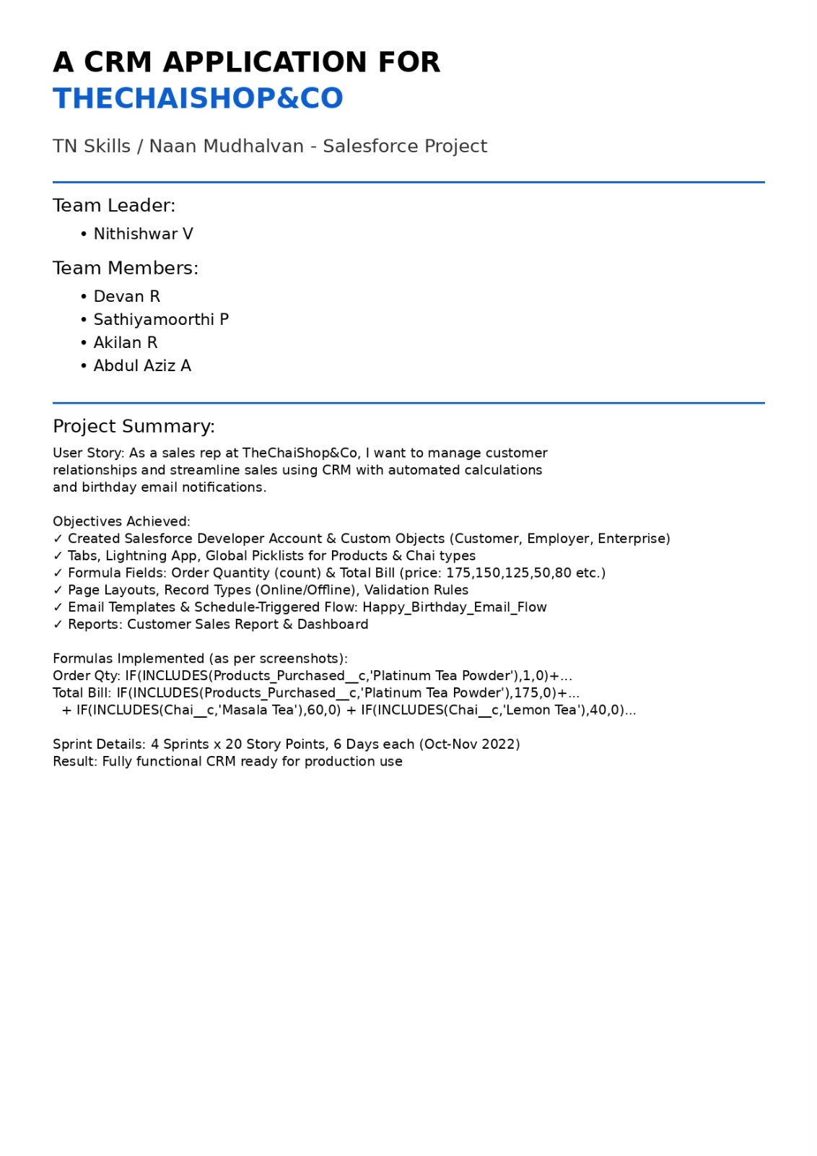

Slide 2
A CRM APPLICATION FOR THECHAISHOP&CO
User Story:
As a sales representative at TheChaiShop&Co, I want to efficiently manage customer relationships and streamline sales processes using our CRM application.
I want to easily access and update employer details, as well as distinguish between online and offline customer records using record types, allowing for personalized interactions.
Additionally, I need the application to automate sales calculations, such as order quantity and total bill amount, to ensure accurate and efficient transactions.
Moreover, I require the ability to generate insightful reports and dashboards to summarize and analyze sales data effectively, aiding in decision-making and strategy development.
Lastly, I would like the application to automate email notifications to customers on their birthdays, informing them of special offers tailored to celebrate their special day, enhancing customer engagement and loyalty.
INTRODUCTION
  Project Overview :
The project “A CRM Application for TheChaiShop&Co” focuses on developing a Salesforce-based Customer Relationship Management (CRM) system to manage customer, employer, and enterprise accounts efficiently. The system automates sales processes, maintains customer records, generates reports, and improves customer engagement through automated notifications.
The project user story and objectives are defined in the initial section of the document
  Purpose :

Slide 3
The purpose of this project is to:
Streamline customer relationship management
Automate billing and order calculations
Improve data accuracy
Enable data-driven decision-making
Enhance customer engagement through email automation
IDEATION PHASE
  Problem Statement (Customer Problem Statement Template)
PS | I am (Customer) | I’m trying to | But | Because | Which makes me feel
PS-1 | Sales Representati ve | Manage customer orders and billing | Calculations are often incorrect | Order quantity and billing are manual | Stressed and inefficient
PS-2 | Store Manager | Monitor sales and customer records | Reports are delayed and incomplete | Data is stored in multiple files | Confused and dissatisfied
PS-3 | Customer | Receive personalized offers and updates | I do not get timely notifications | There is no automated communicat ion | Disconnecte d and undervalued

Slide 4
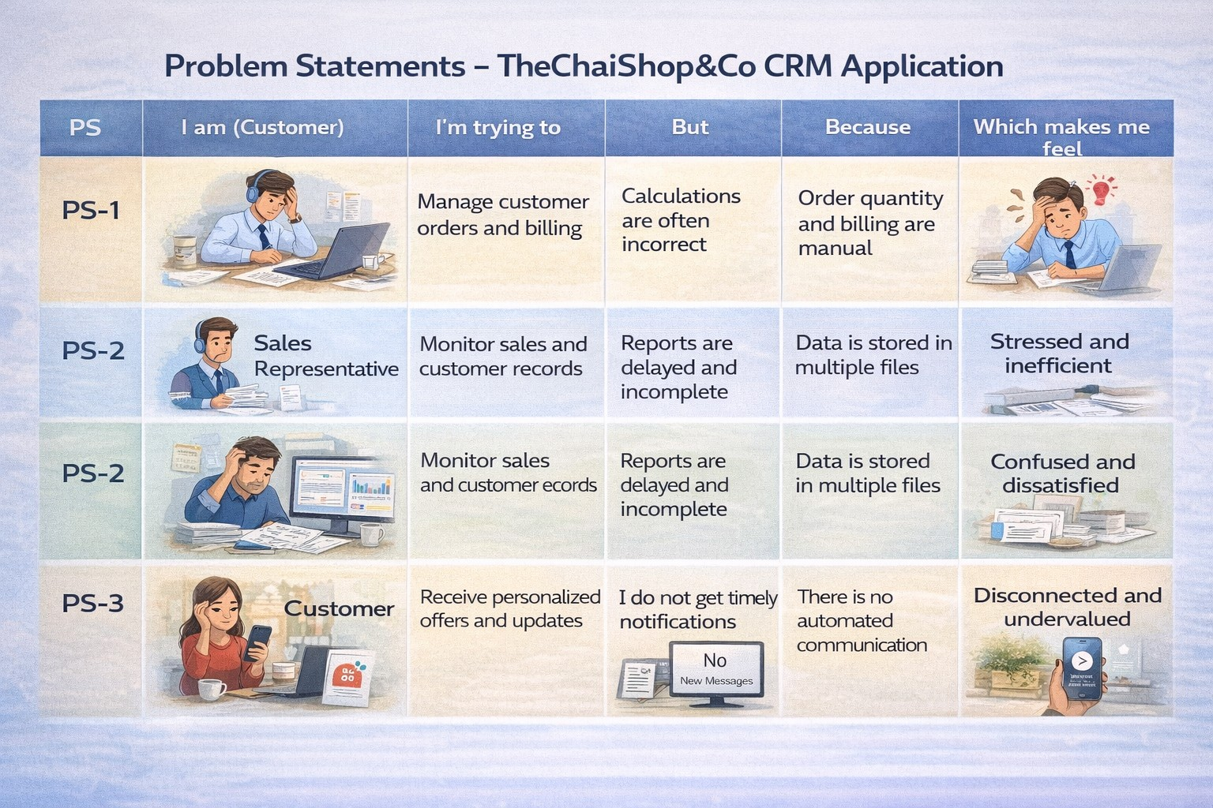
2.2 Empathy Map Canvas
Target Users
Sales Representatives
Managers
System Administrators
Business Analysts
Empathy Analysis
Aspect | Description
Think & Feel | Need accurate customer data and reports

Slide 5
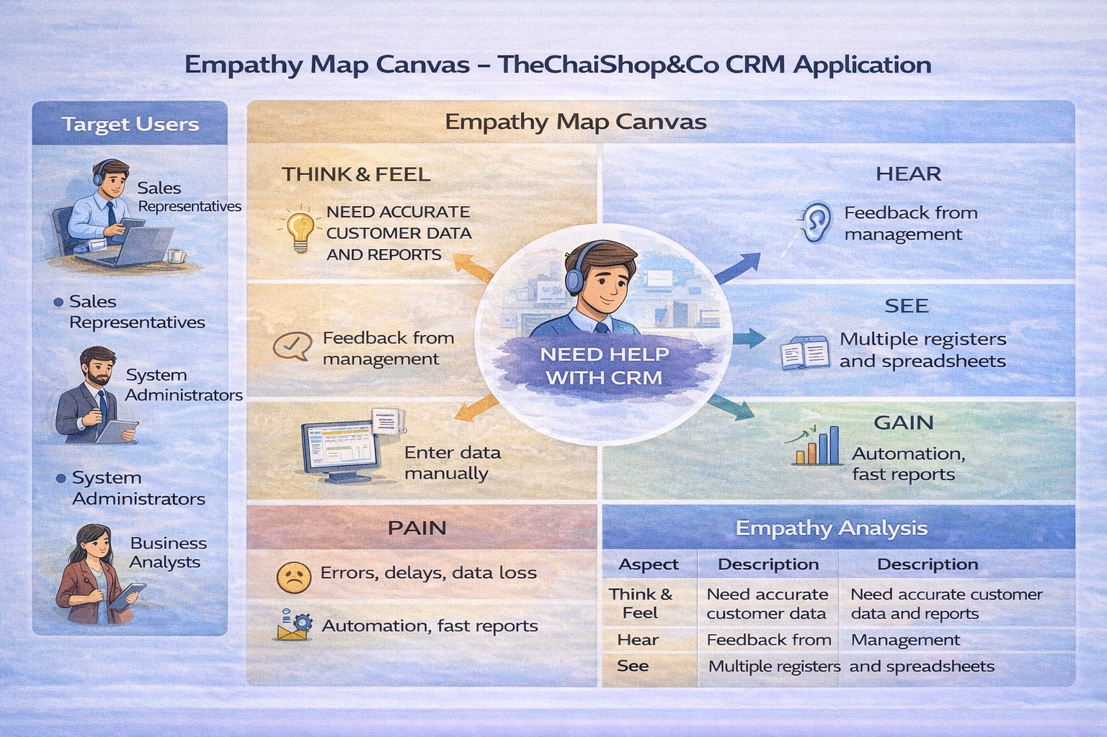
Hear | Feedback from management
See | Multiple registers and spreadsheets
Say & Do | Enter data manually
Pain | Errors, delays, data loss
Gain | Automation, fast reports
2.3 Brainstorming
Brainstormed Ideas
Manual CRM system
Excel-based management
Web-based CRM

Slide 6
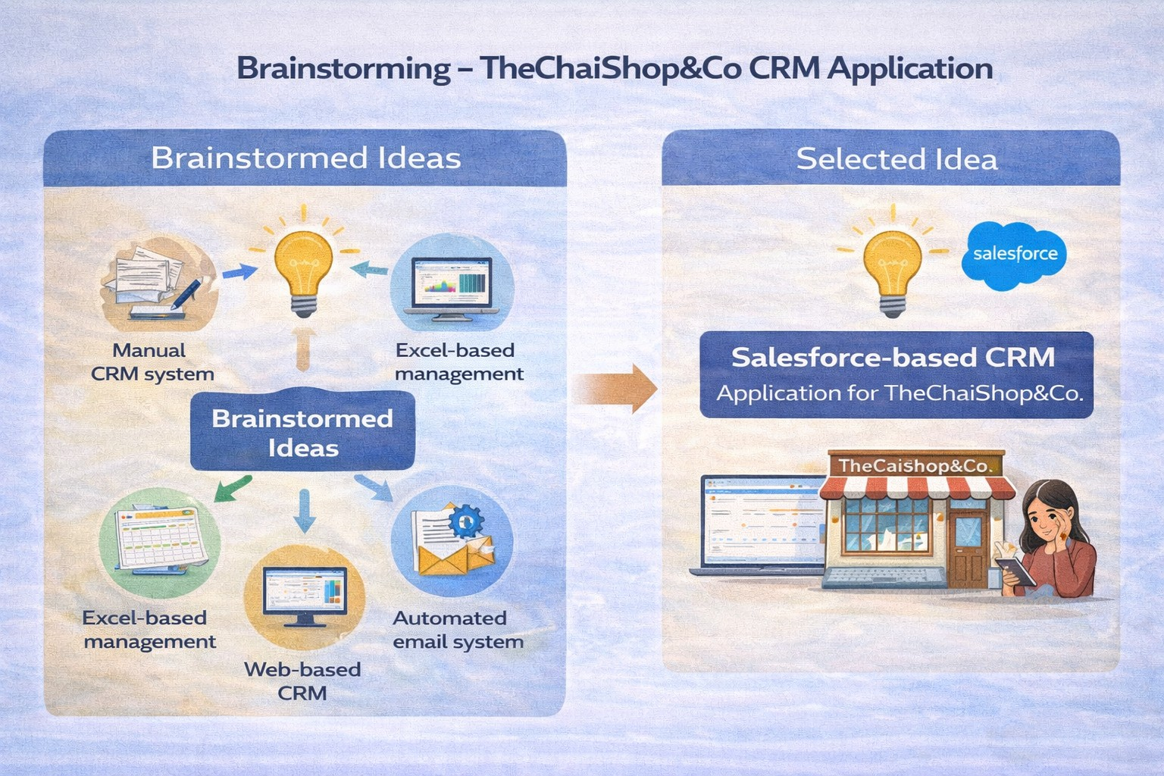
Salesforce-based CRM
Automated email system
Selected Idea:
Salesforce-based CRM Application for TheChaiShop&Co..
REQUIREMENT ANALYSIS PHASE
  Customer Journey Map
Journey Stages:
    Login
    Access CRM Application
    Enter Customer Data

Slide 7
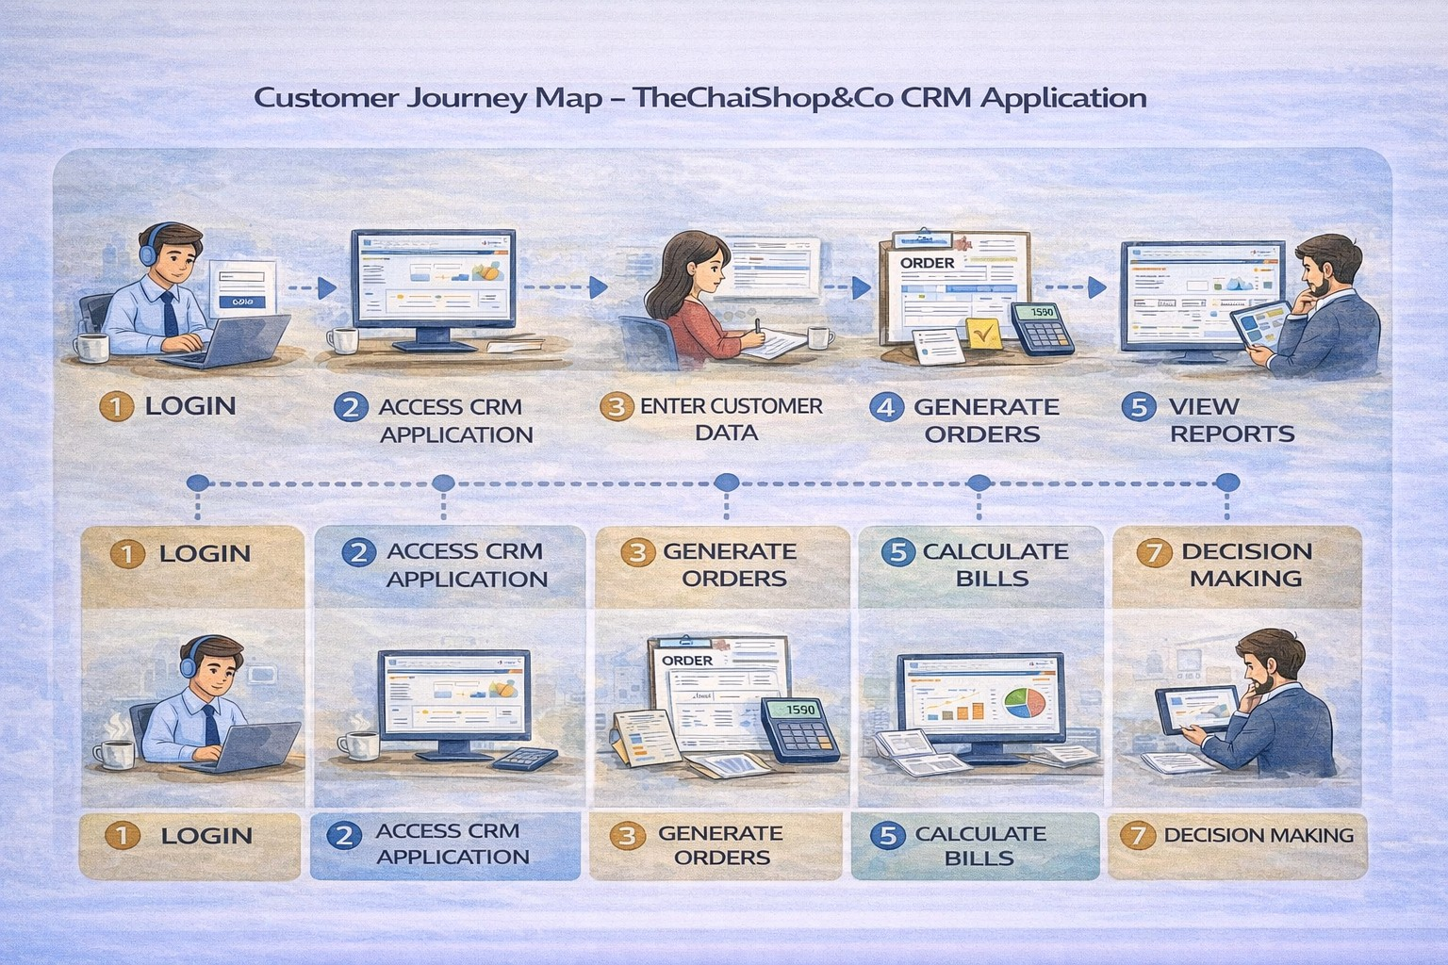
Generate Orders
Calculate Bills
View Reports
Decision Making
3.2 Solution Requirements
Functional Requirements
FR No | Requirement
FR-1 | User Login

Slide 8
FR-2 | Object Creation
FR-3 | Data Entry
FR-4 | Billing Automation
FR-5 | Report Generation
FR-6 | Email Automation
Non-Functional Requirements NFR-1: Usability
The system should be easy to use for sales representatives, managers, administrators, and analysts without requiring technical training.
Requirements :
Simple and intuitive user interface
Clear navigation menus
Easy-to-understand forms
User-friendly dashboards
Example:
A new sales employee should be able to log in, enter customer details, and generate orders within a few minutes without help.
Salesforce Lightning UI provides drag-and-drop features and easy navigation.
NFR-2: Security
The system must protect customer and business data from unauthorized access.
Requirements:
Role-based access control
Secure login authentication
Encrypted data storage

Slide 9
Data backup and recovery
Examples:
Profiles and permission sets
Object-level and field-level security
Restricted billing access
Secure login and password policies
NFR-3: Reliability
The CRM system should work correctly at all times and store data accurately without loss.
Requirements:
Automatic data saving
Regular system backups
Error handling mechanisms
Stable cloud environment
Example :
If a user enters order data and the internet disconnects, the system should save the information and restore it later.
Salesforce cloud ensures automatic backups.
NFR-4: Performance
The system should respond quickly and handle large amounts of data efficiently.
Requirements:
Fast page loading
Quick report generation
Smooth dashboard rendering
Minimal delay

Slide 10
Example: When a manager generates monthly sales reports for hundreds of customers, the report should load within 2–3 seconds.
Optimized queries and caching improve speed.
NFR-5: Availability
The system should be accessible whenever required.
Requirements:
24/7 system availability
Minimal downtime
Cloud-based hosting
Disaster recovery
Example: Managers should be able to access the CRM system during peak business hours, weekends, or late nights.
Salesforce cloud provides high uptime.
NFR-6: Scalability
The system should support business growth without affecting performance.
Requirements:
Ability to handle more users
Support increasing customer data
Expandable storage
Maintain system speed
Example: If TheChaiShop&Co expands to multiple branches, the CRM system should support thousands of customers without slowing down.
Salesforce infrastructure automatically scales.
3.3 Data Flow Diagram
User → Salesforce UI → Custom Objects → Validation Rules → Flows → Reports → Dashboards.

Slide 11
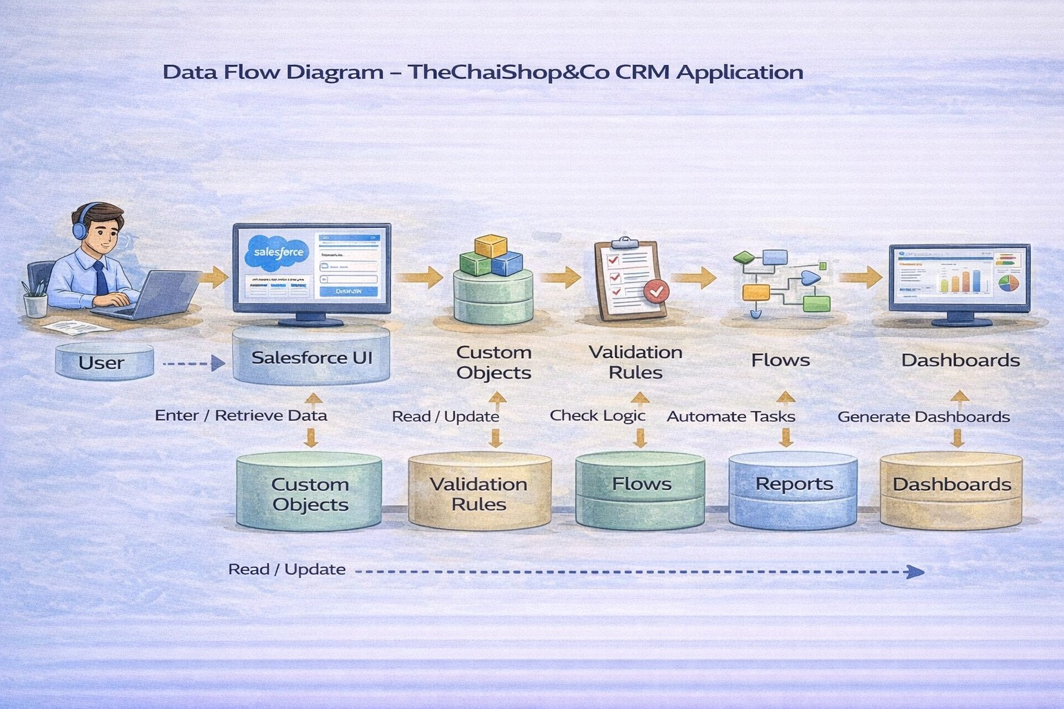
3.4 Technology Stack
Layer | Technology
Frontend | Salesforce Lightning
Database | Salesforce Cloud
Automation | Flows
Backend | Salesforce Platform
Analytics | Reports & Dashboards

Slide 12
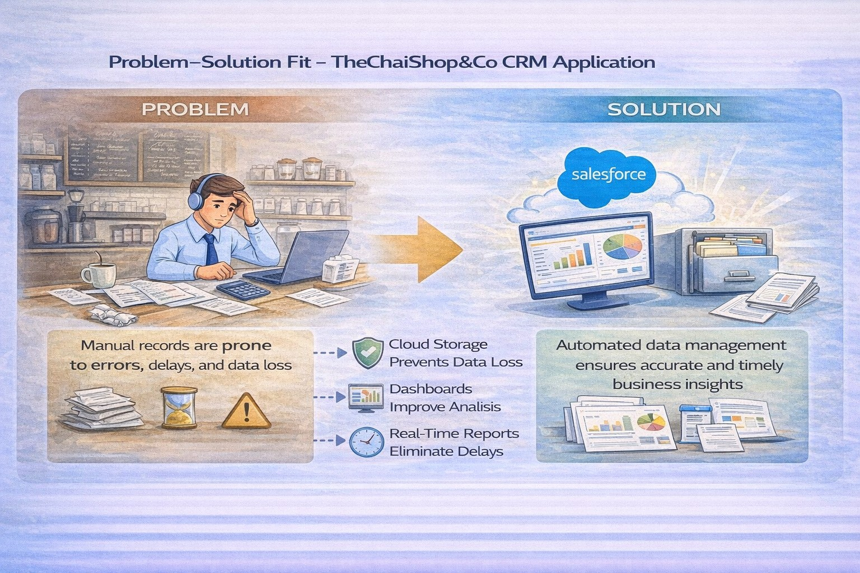
PROJECT DESIGN PHASE
  Problem–Solution Fit
The CRM system replaces manual records with automated data management. Cloud storage prevents data loss, dashboards improve analysis, and real-time reports eliminate delays. This ensures accurate and timely business insights generation.
4.2 Proposed Solution
Functional Requirements

Slide 13
Parameter | Description
User Login & Authentication | Allows authorized users to securely log in to the CRM system using valid credentials.
Customer Record Management | Enables users to create, view, update, and delete customer details such as name, contact number, and address.
Employer & Enterprise Management | Allows management of employer and enterprise account information for business operations.
Order Management | Supports creation and tracking of customer orders, including order quantity and product details.
Automated Billing System | Automatically calculates total bill amount using formula fields based on order quantity and pricing.
Validation Rules | Ensures accurate data entry by validating fields such as phone number, PAN, and Aadhaar.
Record Types & Page Layouts | Provides different record types and layouts for various customer and enterprise categories.
Global Picklists | Maintains standardized values for fields such as product type, category, and status.
Email Notification System | Sends automated emails to customers for birthdays, offers, and order confirmations.
Workflow & Flow Automation | Automates tasks such as updating records and triggering alerts using Salesforce Flows.
Report Generation | Generates detailed reports on sales, customers, and enterprise performance.
Dashboard Visualization | Displays real-time analytics through interactive dashboards and charts.
Data Backup & Recovery | Ensures secure storage and recovery of business data in the Salesforce cloud.
User Role Management | Controls system access using profiles and permission sets for different users.

Slide 14
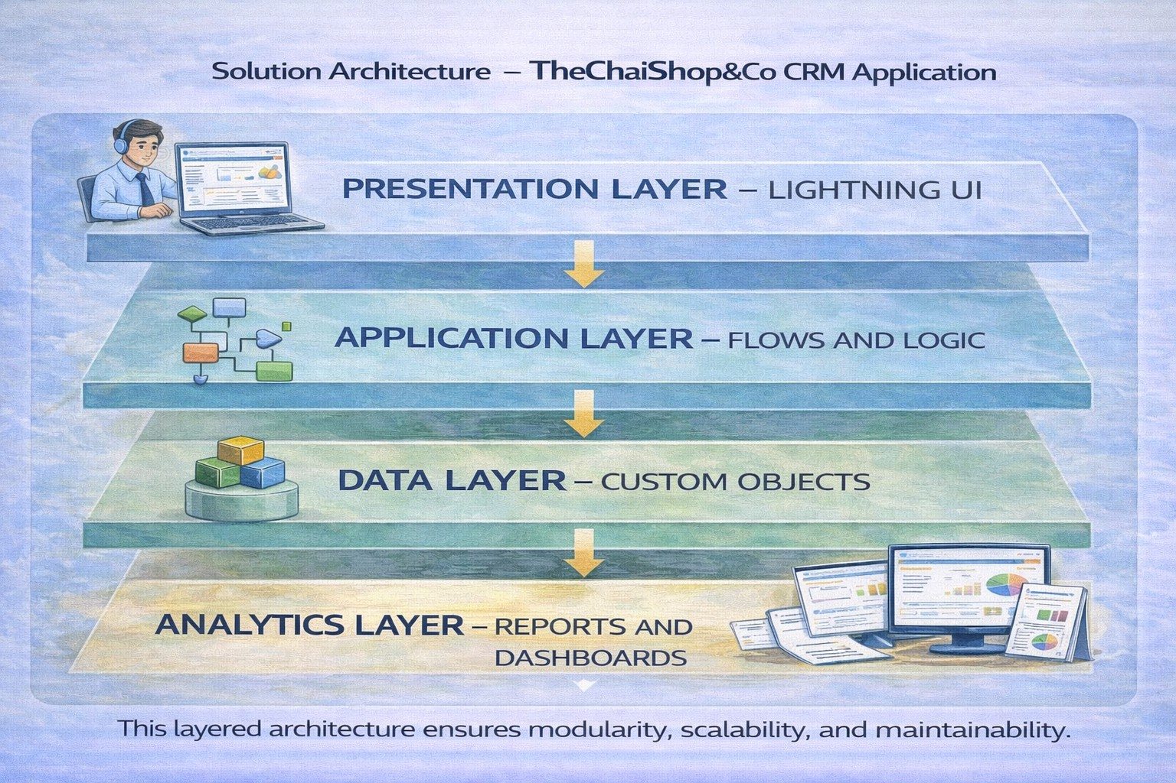
  Solution Architecture
Architecture Layers
    Presentation Layer – Lightning UI
    Application Layer – Flows and Logic
    Data Layer – Custom Objects
    Analytics Layer – Reports and Dashboards
This layered architecture ensures modularity, scalability, and maintainability.

Slide 15
PROJECT PLANNING & SCHEDULING
  Project Planning
    The project followed an Agile-based development approach with defined milestones and sprints.
    A Salesforce Developer account was created to set up the development environment.
    Custom objects were designed to store customer, employer, and enterprise data.
    Custom tabs and a Lightning Application were developed for easy system navigation.
    Fields, relationships, and global picklists were configured to ensure data consistency.
    Page layouts and record types were created based on user roles and customer categories.
    Validation rules were implemented to prevent incorrect data entry.
    Email templates and automated flows were developed for customer notifications.
    Reports and dashboards were created for performance monitoring and analysis.
    Regular sprint reviews and testing were conducted to track progress and resolve issues.
    The project was completed within the planned timeline through systematic scheduling.
Product Backlog, Sprint Schedule, and Estimation (4 Marks)
Use the below template to create product backlog and sprint schedule
Sprint | Functional Requirement (Epic) | User Story Number | User Story / Task | Story Points | Priority | Team Member s
Sprint-1 | Developer Setup | USN-1 | As an admin, I want to create a Salesforce developer account so that I can configure and deploy the TheChaiShop&Co CRM application. | 1 | High | Member1
Sprint-1 | Data Modeling | USN-2 | As an admin, I want to create Customer, Employer, and Enterprise objects so that business data can be stored and managed systematically. | 3 | High | Member2
Sprint-2 | Data Modeling | USN-3 | As a user, I want separate tabs for each object so that I can easily navigate and manage CRM records within the application. | 3 | High | Member3

Slide 16
Sprint | Functional Requirement (Epic) | User Story Number | User Story / Task | Story Points | Priority | Team Member s
Sprint-2 | Data Modeling | USN-4 | As a manager, I want a dedicated Lightning App so that all CRM operations are accessible from a single dashboard. | 3 | High | Member4
Sprint-2 | Data Modeling | USN-5 | As an admin, I want to create customer and order fields so that complete sales and billing details can be captured accurately. | 5 | Medium | Member1
Sprint-2 | Data Modeling | USN-6 | As a user, I want customized page layouts for different record types so that only relevant information is displayed during data entry | 5 | High | Member2
Sprint-2 | Data Modeling | USN-7 | As a manager, I want separate record types for Retail and Enterprise customers so that different business categories can be managed efficiently. | 5 | Medium | Member3
Sprint-3 | Automation | USN-8 | As a system, I want to validate customer details and order inputs so that incorrect data entries are prevented. | 3 | High | Member4
Sprint-3 | Automation | USN-9 | As a system, I want automated flows to send email notifications so that customers receive timely updates and offers. | 5 | High | Member1
Sprint-4 | Automation | USN-10 | As a system, I want to automatically calculate billing amounts so that invoices are generated without manual effort. | 5 | High | Member2
Sprint-5 | Reports | USN-11 | As a manager, I want sales and customer reports so that I can monitor business performance and make informed decisions. | 4 | High | Member3
Sprint-6 | Dashboards | USN-12 | As a manager, I want visual dashboards so that I can quickly analyze sales, customers, and enterprise performance. | 4 | Medium | Member4
Project Tracker, Velocity & Burndown Chart: (4 Marks)

Slide 17
Sprint | Total Story Points | Duratio n | Sprint Start Date | Sprint End Date (Planned) | Story Points Completed (as on Planned End Date) | Sprint Release Date (Actual)
Sprint-1 | 20 | 6 Days | 24 Oct 2022 | 29 Oct 2022 | 20 | 29 Oct 2022
Sprint-2 | 20 | 6 Days | 31 Oct 2022 | 05 Nov 2022
Sprint-3 | 20 | 6 Days | 07 Nov 2022 | 12 Nov 2022
Sprint-4 | 20 | 6 Days | 14 Nov 2022 | 19 Nov 2022
6. Project Development Phase:
Project Flow
Milestone 1 : Creation of developer account Milestone 2 : Object Creation
Milestone 3 : Tabs
Milestone 4 : The Lightning App Milestone 5 : Global Picklist
Milestone 6 : Fields and Relationships Milestone 7 : Creation of Page Layout Milestone 8 : Creation of Record Types Milestone 9 : Validation rules
Milestone 10 : Email Templates Milestone 11 : Flows
Milestone 12 : Reports and Dashboards Milestone 13 : Conclusion
What you'll learn
1. Real Time Salesforce Project

Slide 18
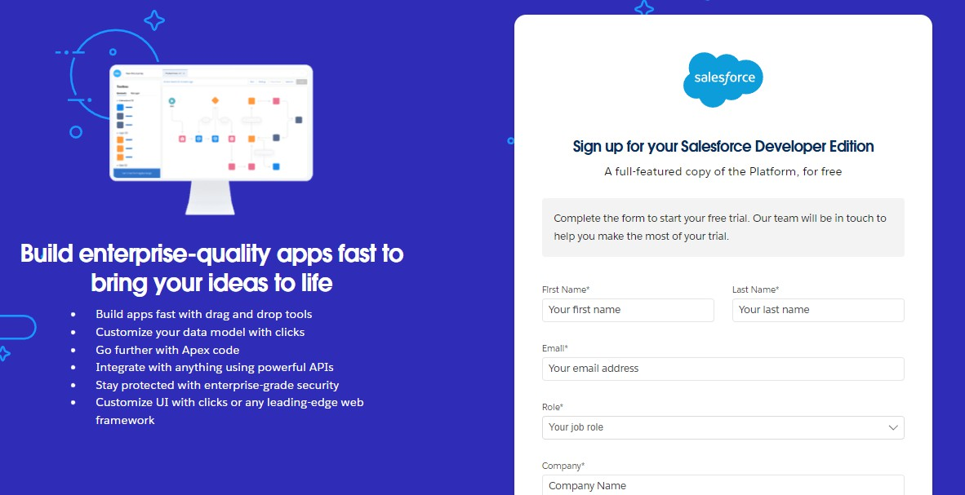
Standard and Custom objects
Picklist Value sets
Types of Fields & their relationships.
Page Layouts
Record Types
Validation Rules
Email Templates
Flows
Reports and Dashboards.
Implementation
Milestone 1 - Salesforce developer account creation : Activity 1: Creating Developer Account:
Creating a developer org in salesforce.
Go to https://developer.salesforce.com/signup
On the sign up form, enter the following details :
First name & Last name
Email
Role : Developer
Company : College or Company Name
County : India

Slide 19
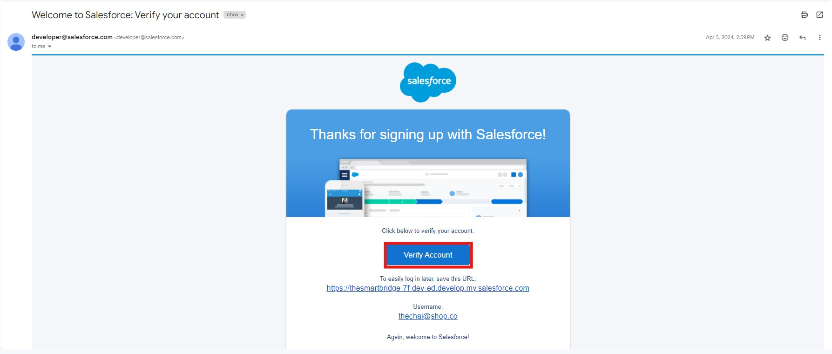
Postal Code : pin code
Username : should be a combination of your name and company
This need not be an actual email id, you can give anything in that format : username@organization.com
Click on sign me up after filling these.
Activity 2: Account Activation :
1. Go to the inbox of the email that you used while signing up. Click on the verify account to activate your account. The email may take 5-10mins.
Click on Verify Account.
Give a password and answer a security question and click on change password.

Slide 20
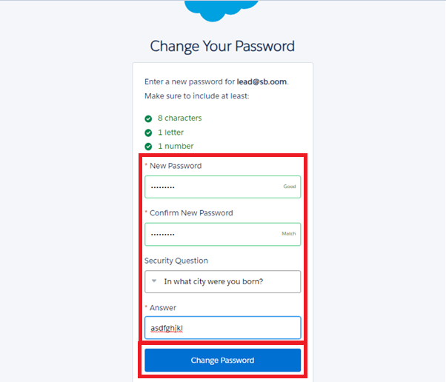
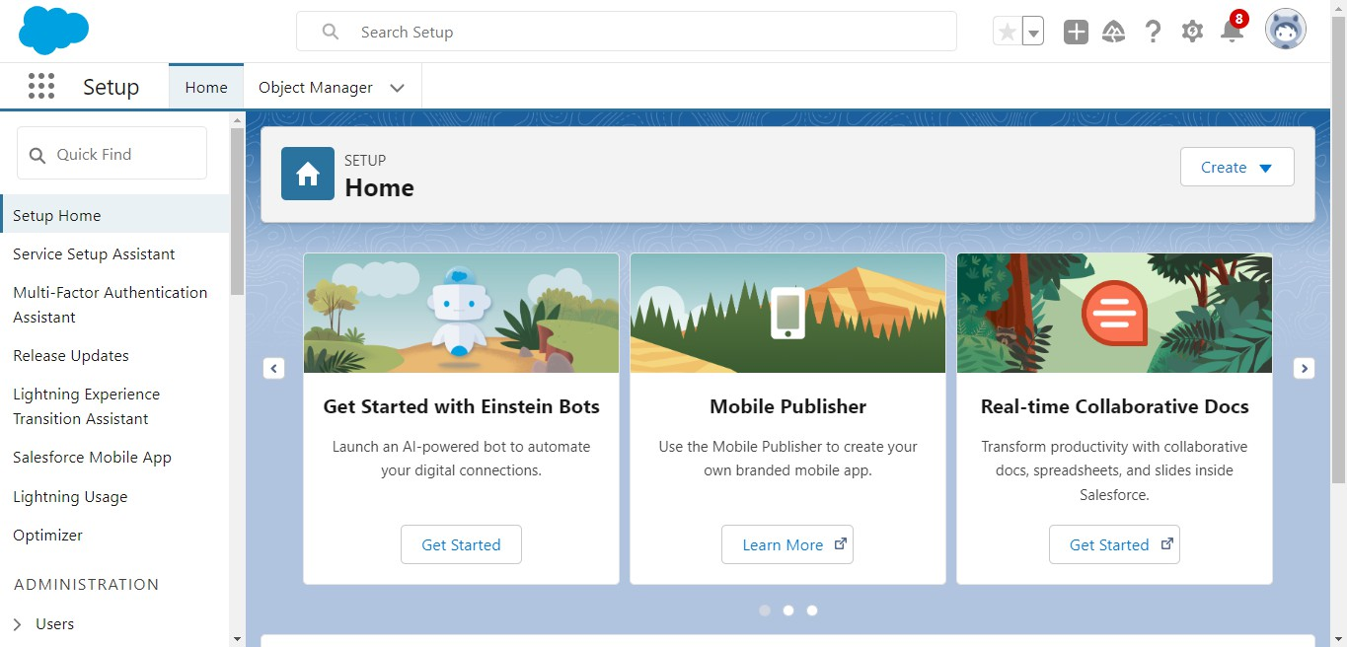
4. Then you will redirect to your salesforce setup page.
Milestone 2 - Objects
1. In your Salesforce org, click gear icon on the top left and select Setup to open Setup.

Slide 21
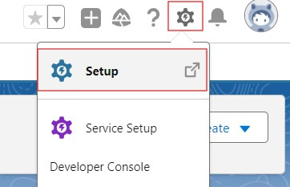
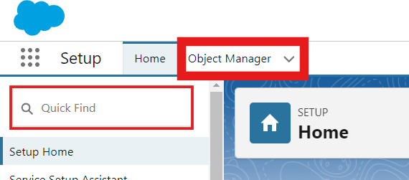
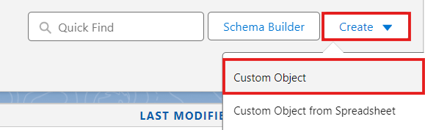
2. Click the Object Manager tab. If you don’t see it, enter Object Manager in the Quick Find box.
3. On the Object Manager page, click Create | Custom Object.
Activity 1 : Employer Account Object
From the setup page → Click on Object Manager → Click on Create → Click on Custom Object.
  Label : Employer Account
  Plural Label : Employer Accounts
  Enter Record Name Label and Format
Record Name : Employer Account Name Data Type : Text
  In Optional features : check the boxes for Allow Reports | Allow Activities
| Track Field History.
  Search Status : check the box for Allow Search.
  Save

Slide 22
Activity 2 : Customer Account Object
From the setup page → Click on Object Manager → Click on Create → Click on Custom Object.
  Label : Customer Account
  Plural Label : Customer Accounts
  Enter Record Name Label and Format
Record Name : Customer Account Name Data Type : Text
  In Optional features : check the boxes for Allow Reports | Allow Activities
| Track Field History.
  Search Status : check the box for Allow Search.
  Save
Activity 3 : Enterprise Account Object
From the setup page → Click on Object Manager → Click on Create → Click on Custom Object.
  Label : Enterprise Account
  Plural Label : Enterprise Accounts
  Enter Record Name Label and Format
Record Name : Enterprise Account Name Data Type : Text
  In Optional features : check the boxes for Allow Reports | Allow Activities
| Track Field History.
  Search Status : check the box for Allow Search.
  Save
Milestone 3 - Tabs
Activity 1 : Custom tabs creation
1. Go to setup page → type Tabs in Quick Find bar → click on tabs → New (under custom object tab)

Slide 23
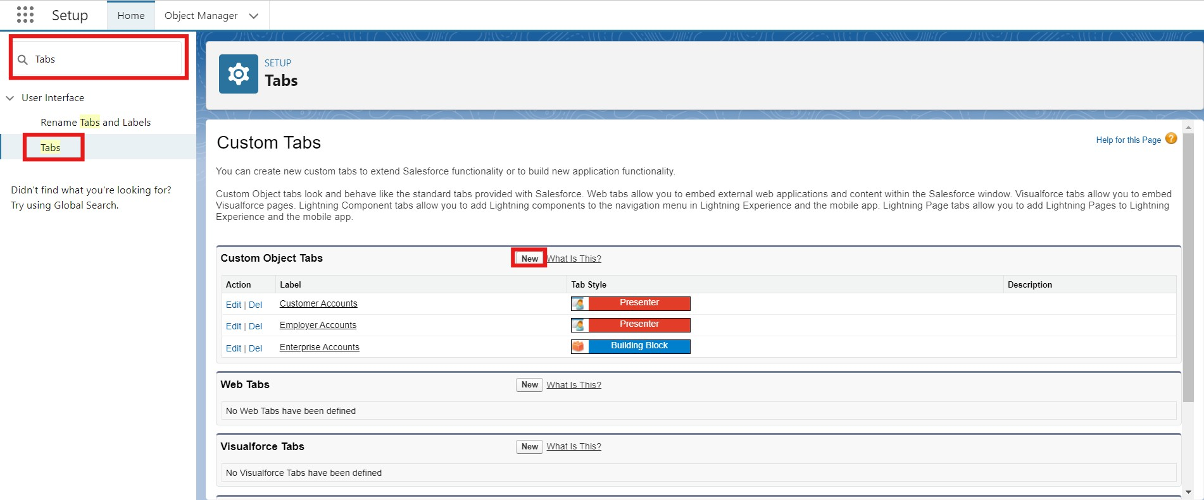
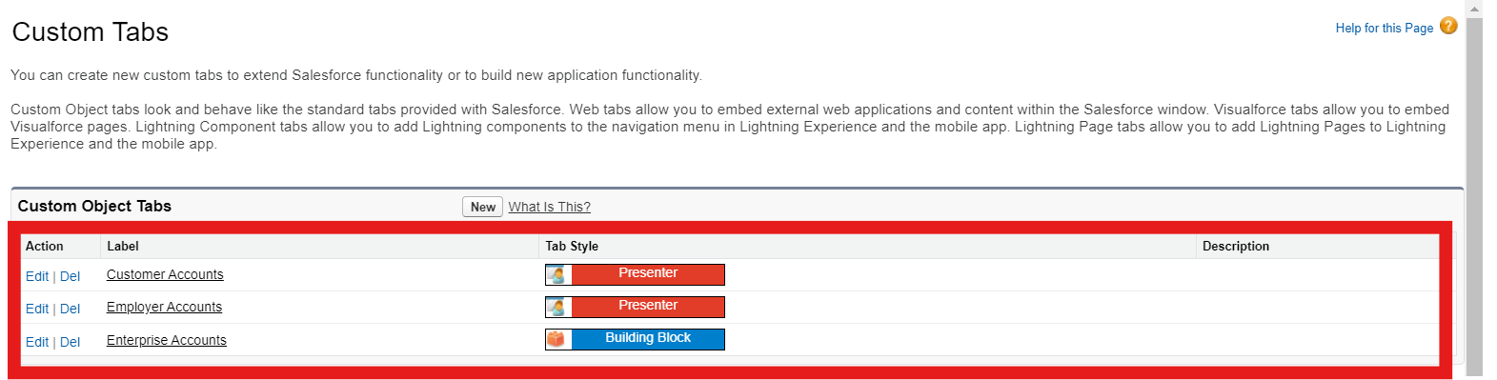
Select Object(Employer Accounts) → Select the tab style → Next (Add to profiles page) keep it as default → Next (Add to Custom App) uncheck the include tab .
Make sure that the Append tab to users' existing personal customizations is checked.
Click save.
Repeat the same steps for Customer Accounts and Enterprise Accounts.
Milestone 4 - The Lightning App
Activity 1 : Create a lightning app
1. Go to setup page → search “app manager” in quick find → select “app manager”
→ click on New lightning App.

Slide 24
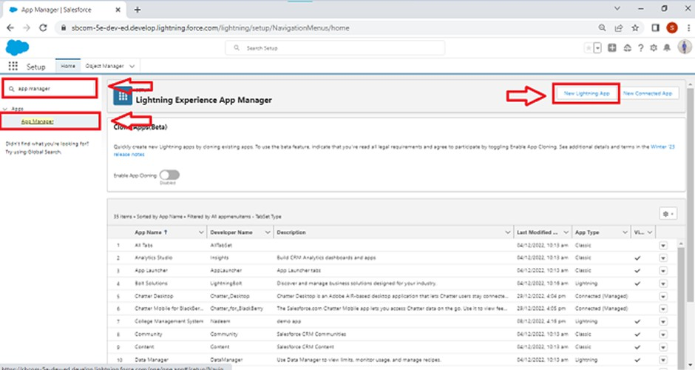
Fill the app name in app details and branding as follow App Name : TheChaiShop&Co
Developer Name : Auto Populates
Add image optional (if you want to give any image you can otherwise not mandatory) - Add Primary color Hex or leave it to default.
Then click Next.
In App options
Navigation style : Standard navigation Setup experience : setup
Supporters form factors : Desktop and phone Then click Next
In Utility items
Utility Bar alignment : Default Then click Next.
Navigation items
Select the created Custom Objects and required standard objects
  Customer Accounts Employer Accounts Enterprise Accounts Reports Dashboards

Slide 25
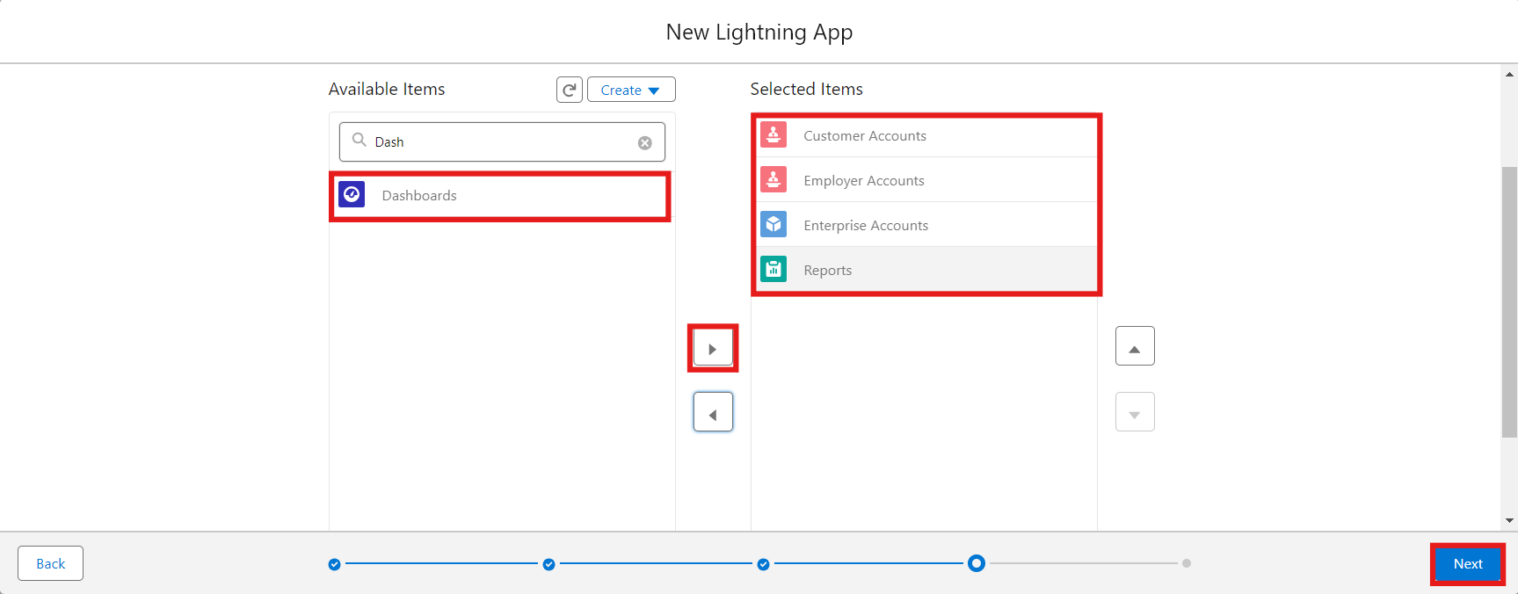
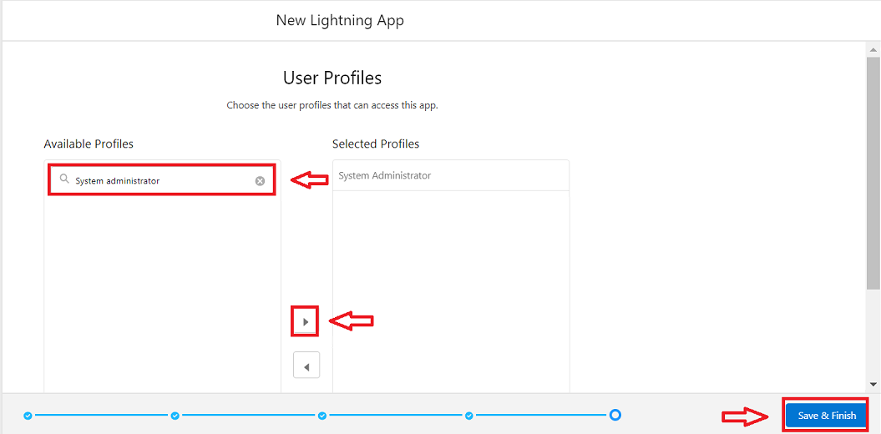
6. To Add User Profiles : System Administrator
7. Click Save & Finish.
Milestone 5 : Global Picklist
Activity 1 : Create Global PIcklist
1. In Quick find box search for : Picklist value sets and click New.

Slide 26
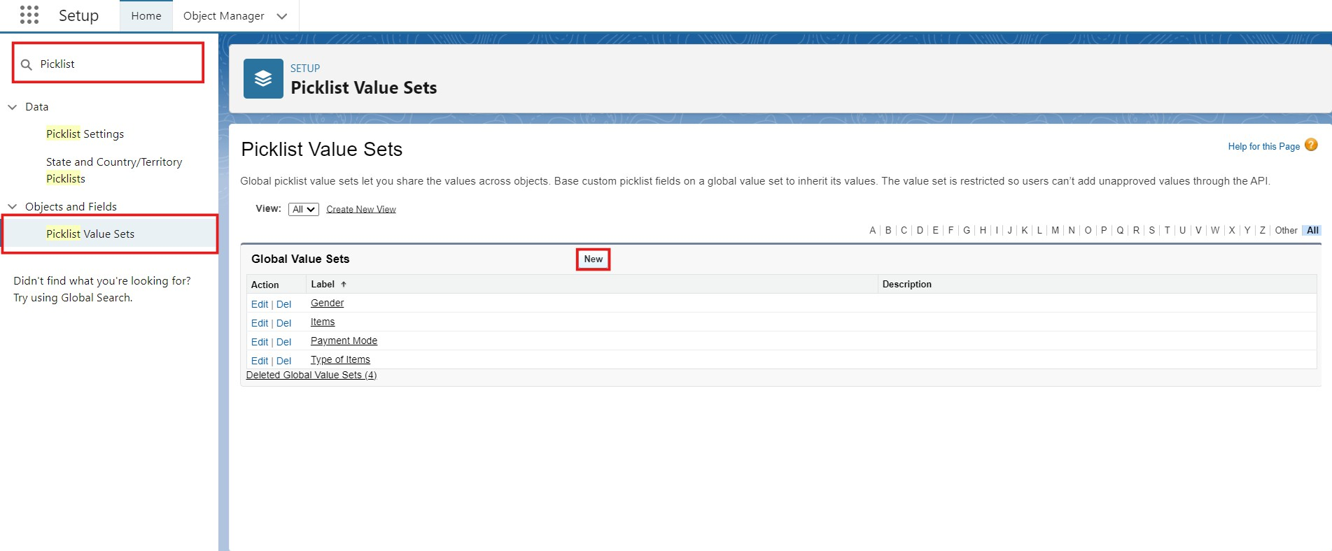
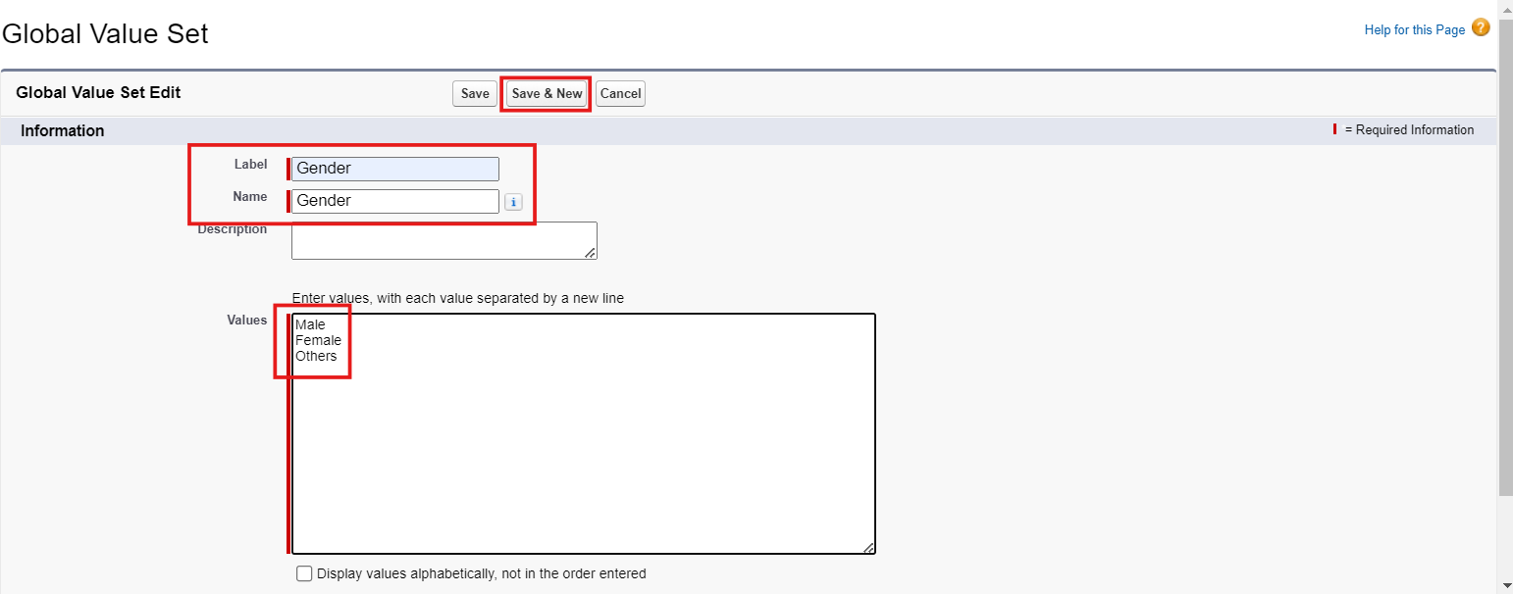
Label : Gender
Name : Auto Populates
Values : Male
Female Others
Click Save & New.
Create three more Global picklists following the same steps.
  Label : Items
Name : Auto populates
Values : Platinum Tea Powder Double Delight Tea Powder Super Dust Tea Powder
Osmania Biscuits (Value Pack) Osmania Biscuits (Premium Pack) Dry Fruit Biscuits
Fruit Biscuits

Slide 27
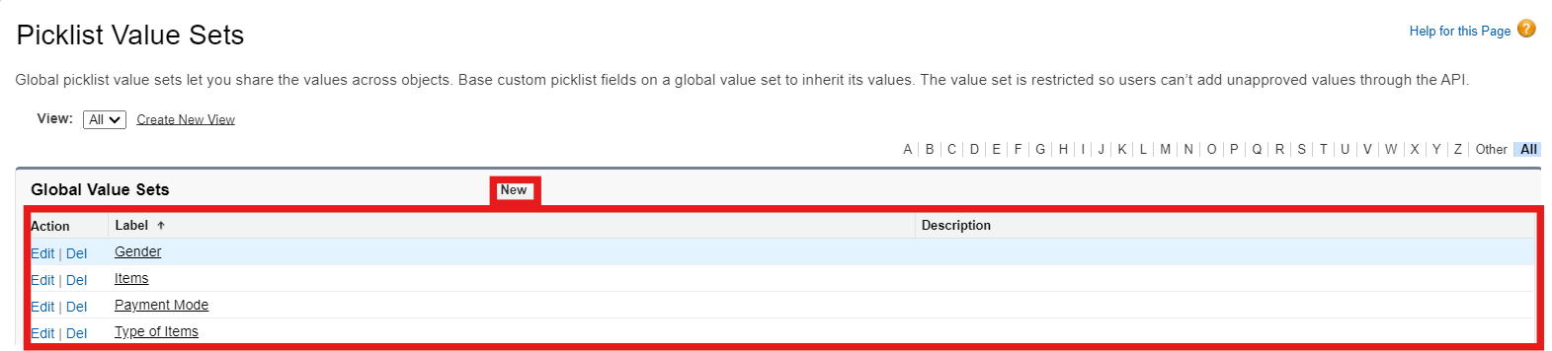
Salt Biscuits Multigrain Biscuits Ragi Biscuits
Double Choco Chip Cookies Butter Almond Cookies Melting Moments Cookies Honey Oats Cookies
Delight Box Signature Box Assorted Box
Click Save & New.
Label : Payment Mode Name : Auto populates Values : Gpay
PhonePe Paytm
Credit or Debit card Cash.
Click Save & New.
Label : Type of Items Name : Auto populates Values : Tea powder
Cookies
Gift Hampers Click Save.

Slide 28
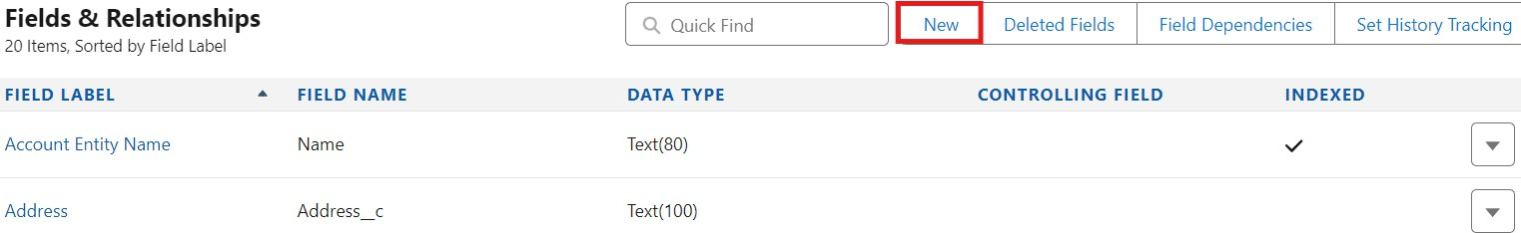
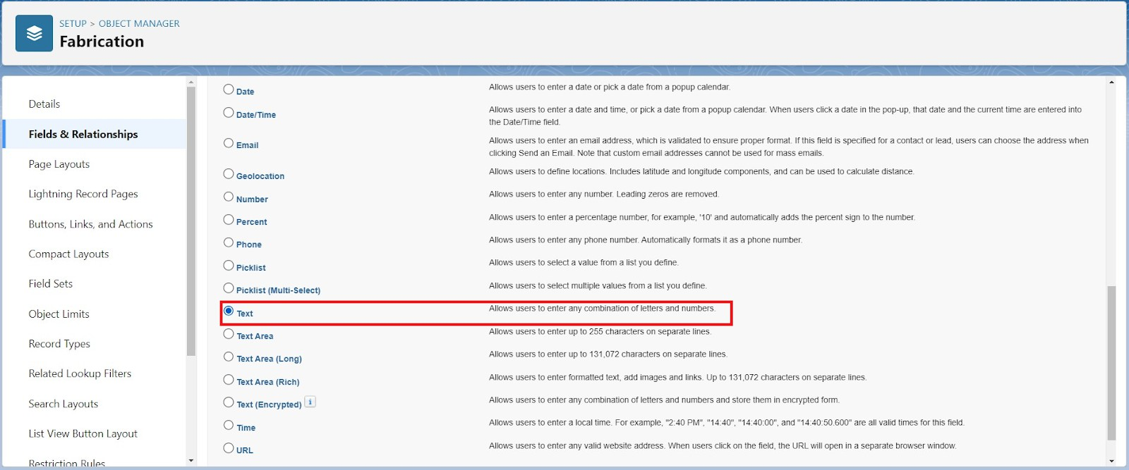
Milestone 6 : Fields & Relationships
Activity 1 : Create Custom fields for Employer Account
In your Salesforce org, click gear icon on the top left and select Setup to open Setup.
Click the Object Manager tab. If you don’t see it, enter Object Manager in the Quick Find box.
From the object manager page, In the Quick Find box, Search for the custom object you just created : Employer Account
From the sidebar, click Fields & Relationships. Notice that there are already some fields there. Those are the standard fields.
Click New to create a custom field. Tip: Before creating a new field, do a quick search to make sure a similar one doesn’t already exist.
6. Next, choose a data type as Text. Choosing a data type helps you format the field input.
7. Click on next.

Slide 29
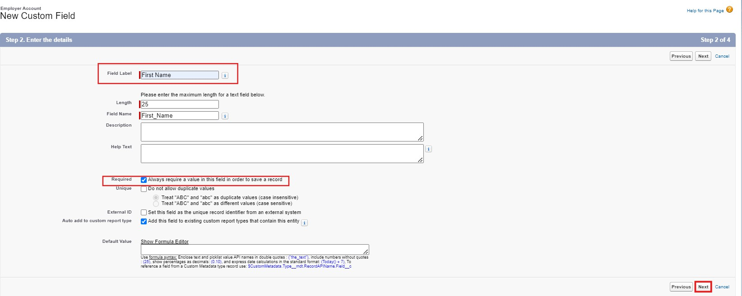
Data Type : Text
Field Label: First Name
Field Name : Auto Populates Length : 25
Required : Check the box
Click on Next → Next → Save and new.
Repeat the Same steps for remaining fields
  Data Type : Text
Field Label: Last Name
Field Name : Auto Populates Length : 25
Required : Check the box
Click on Next → Next → Save and new.
  Data Type : PickList
Field Label: Gender
Values : Use Global Picklist value set and select Gender from the dropdown menu.
Field Name : Auto Populates. Required : Check the box
Click on Next → Next → Save and new.

Slide 30
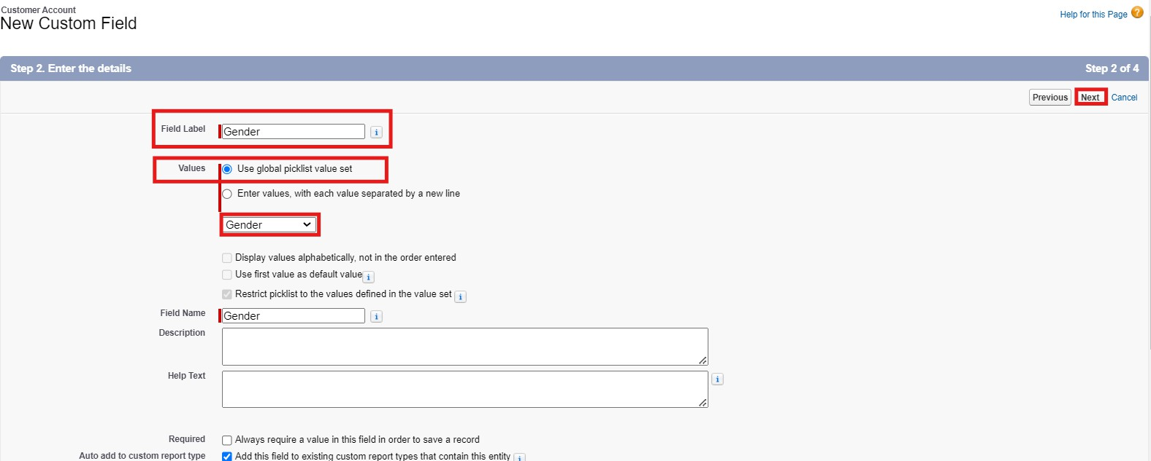
Data Type : Phone
Field Label : Phone Number Field Name : Auto Populates Required : Check the box
Click on Next → Next → Save and new.
Data Type : Email Field Label : Email ID
Field Name : Auto Populates Required : Check the box
Click on Next → Next → Save and new.
Data Type : Date
Field Label : Date of Birth Field Name : Auto Populates Required : check the box
Click on Next → Next → Save and new.
Data Type : Text
Field Label : Aadhar Number Field Name : Auto Populates Length : 12
Click on Next → Next → Save and new.
Data Type : Text
Field Label : PAN Details Field Name : PAN_Details

Slide 31
Length : 10
Click on Next → Next → Save and new.
Data Type : Picklist
Field Label : Designation Field Name : Auto Populates
Value : Enter value, with each value separated by a new line.
Manager
Finance and Accounting Kitchen Staff
Cashier Servers
Click on Next → Next → Save and new.
Data Type : Currency
Field Label : Salary
Field Name : Auto Populates
Click on Next → Next → Save.
Activity 2: Create Custom fields for Customer Account
Data Type : Text
Field Label: First Name
Field Name : Auto Populates Length : 25
Required : Check the box
Click on Next → Next → Save and new.
Data Type : Text
Field Label: Last Name
Field Name : Auto Populates Length : 25
Required : Check the box
Click on Next → Next → Save and new.
Data Type : PickList
Field Label: Gender
Values : Use Global Picklist value set and select Gender from the dropdown menu.

Slide 32
Field Name : Auto Populates. Required : Check the box
Click on Next → Next → Save and new.
Data Type : Phone
Field Label : Phone Number Field Name : Auto Populates Required : Check the box
Click on Next → Next → Save and new.
Data Type : Date
Field Label : Date of Birth Field Name : Auto Populates Required : check the box
Click on Next → Next → Save and new.
Data Type : Formula
Field Label : Date of Birthday is today ? Field Name : Auto Populates
Formula Return : Checkbox
Formula :
IF( AND(
DAY( TODAY() ) = DAY( Date_of_Birth c ) , MONTH ( TODAY()) = MONTH( Date_of_Birth c )), TRUE,
FALSE)
Click on Next → Next → Save and new.
Data Type : Email Field Label : Email ID
Field Name : Auto Populates Required : Check the box
Click on Next → Next → Save and new.
Date Type : Text Field Label : Address
Field Name : Auto Populates Length : 125
Click on Next → Next → Save and new.

Slide 33
Date Type : Multi Select Picklist
Field Label : Type of Items
Values : Use Global Picklist value set and select Type of Items from the dropdown menu. Field Name : Auto Populates.
Required : Check the box
Click on Next → Next → Save and new.
Date Type : Multi Select Picklist
Field Label : Products purchased
Values : Use Global Picklist value set and select Items from the dropdown menu.
Field Name : Auto Populates. Required : Check the box
Click on Next → Next → Save and new.
Date Type : Multi Select Picklist
Field Label : Chai
Value : Enter value, with each value separated by a new line.
TheChaiShop&Co Special Tea Single Tea
Masala Tea Lemon Tea Ginger Tea Green Tea Sugar Free Tea
Click on Next → Next → Save and new.
Data Type : Picklist
Field Label : Payment Mode
Values : Use Global Picklist value set and select Payment Mode from the dropdown menu. Field Name : Auto Populates.
Required : Check the box
Click on Next → Next → Save and new.
Data Type : Lookup Relationship Related To : Employer Account Field Label : Associated Employer Field Name : Auto Populates
Click on Next → Next → Save and new.

Slide 34
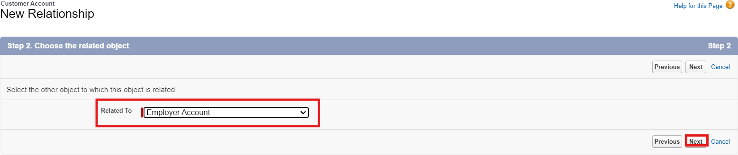
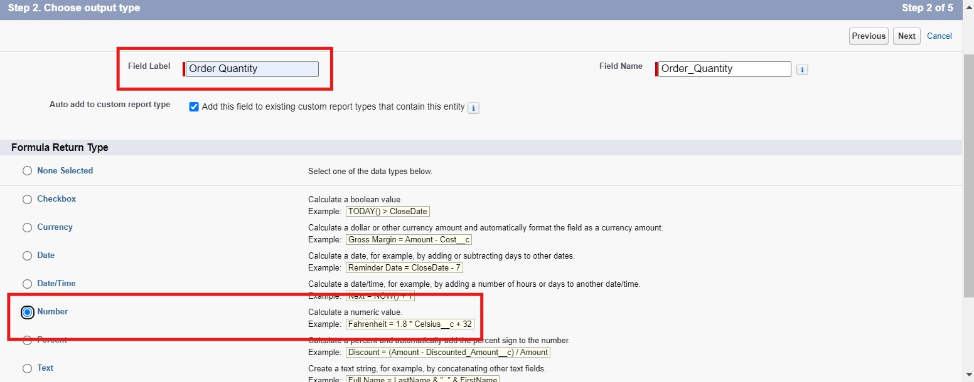
14. Data Type : Formula
Field Label : Order Quantity
Field Name : Auto Populates Formula Return : Number
Enter Formula = Quantity (Number) =
IF(INCLUDES( Products_Purchased c , "Platinum Tea Powder"), 1, 0 ) +
IF(INCLUDES( Products_Purchased c , "Double Delight Tea Powder"), 1, 0 ) + IF( INCLUDES( Products_Purchased c , "Super Dust Tea Powder") , 1, 0) +
IF(INCLUDES( Products_Purchased c , "Osmania Biscuits (Value Pack)"), 1, 0 ) + IF(INCLUDES( Products_Purchased c , "Osmania Biscuits (Premium Pack)"), 1, 0 ) + IF( INCLUDES( Products_Purchased c , "Dry Fruit Biscuits") , 1, 0) +
IF(INCLUDES( Products_Purchased c , "Fruit Biscuits"), 1, 0 ) + IF(INCLUDES( Products_Purchased c , "Salt Biscuits"), 1, 0 ) + IF(INCLUDES( Products_Purchased c , "Multigrain Biscuits"), 1, 0 ) + IF(INCLUDES( Products_Purchased c , "Ragi Biscuits"), 1, 0 ) +
IF( INCLUDES( Products_Purchased c ,"Double Choco chip Cookies") , 1, 0) + IF(INCLUDES( Products_Purchased c , "Butter Almond Cookies"), 1, 0 ) + IF(INCLUDES( Products_Purchased c , "Melting Moments Cookies"), 1, 0 ) + IF( INCLUDES( Products_Purchased c , "Honey Oats Cookies") , 1, 0) + IF(INCLUDES( Products_Purchased c , "Delight Box"), 1, 0 ) +
IF(INCLUDES( Products_Purchased c , "Signature Box"), 1, 0 ) + IF( INCLUDES( Products_Purchased c , "Assorted Pack") , 1, 0) + IF(INCLUDES( Chai c , "TheChaiShop&Co Special Tea"), 1, 0) + IF(INCLUDES( Chai c , "Single Tea"), 1, 0) +
IF(INCLUDES( Chai c , "Masala Tea"), 1, 0) +

Slide 35
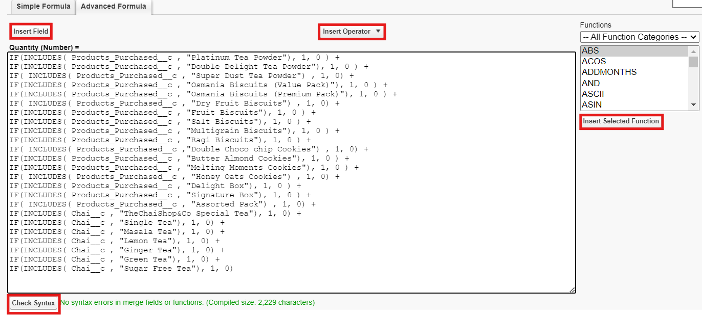
IF(INCLUDES( Chai c , "Lemon Tea"), 1, 0) + IF(INCLUDES( Chai c , "Ginger Tea"), 1, 0) + IF(INCLUDES( Chai c , "Green Tea"), 1, 0) + IF(INCLUDES( Chai c , "Sugar Free Tea"), 1, 0)
Click on Next → Next → Save and new.
15. Data Type : Formula
Field Label : Total Bill
Field Name : Auto Populates Formula Return : Number
Enter Formula = Quantity (Number) =
IF(INCLUDES( Products_Purchased c , "Platinum Tea Powder"), 175, 0 ) + IF(INCLUDES( Products_Purchased c , "Double Delight Tea Powder"), 150, 0 ) + IF( INCLUDES( Products_Purchased c , "Super Dust Tea Powder") , 125, 0) + IF(INCLUDES( Products_Purchased c , "Osmania Biscuits (Value Pack)"), 50, 0 ) +
IF(INCLUDES( Products_Purchased c , "Osmania Biscuits (Premium Pack)"), 80, 0 ) + IF( INCLUDES( Products_Purchased c , "Dry Fruit Biscuits") , 110, 0) + IF(INCLUDES( Products_Purchased c , "Fruit Biscuits"), 160, 0 ) +
IF(INCLUDES( Products_Purchased c , "Salt Biscuits"), 110, 0 ) + IF(INCLUDES( Products_Purchased c , "Multigrain Biscuits"), 170, 0 ) + IF(INCLUDES( Products_Purchased c , "Ragi Biscuits"), 190, 0 ) +
IF( INCLUDES( Products_Purchased c ,"Double Choco chip Cookies") , 200, 0) + IF(INCLUDES( Products_Purchased c , "Butter Almond Cookies"), 110, 0 ) + IF(INCLUDES( Products_Purchased c , "Melting Moments Cookies"), 150, 0 ) + IF( INCLUDES( Products_Purchased c , "Honey Oats Cookies") , 160, 0) + IF(INCLUDES( Products_Purchased c , "Delight Box"), 850, 0 ) +
IF(INCLUDES( Products_Purchased c , "Signature Box"), 1500, 0 ) + IF( INCLUDES( Products_Purchased c , "Assorted Pack") , 600, 0) + IF(INCLUDES( Chai c , "TheChaiShop&Co Special Tea"), 70, 0) + IF(INCLUDES( Chai c , "Single Tea"), 50, 0) +
IF(INCLUDES( Chai c , "Masala Tea"), 60, 0) + IF(INCLUDES( Chai c , "Lemon Tea"), 40, 0) +
IF(INCLUDES( Chai c , "Ginger Tea"),55, 0) + IF(INCLUDES( Chai c , "Green Tea"), 45, 0) +

Slide 36
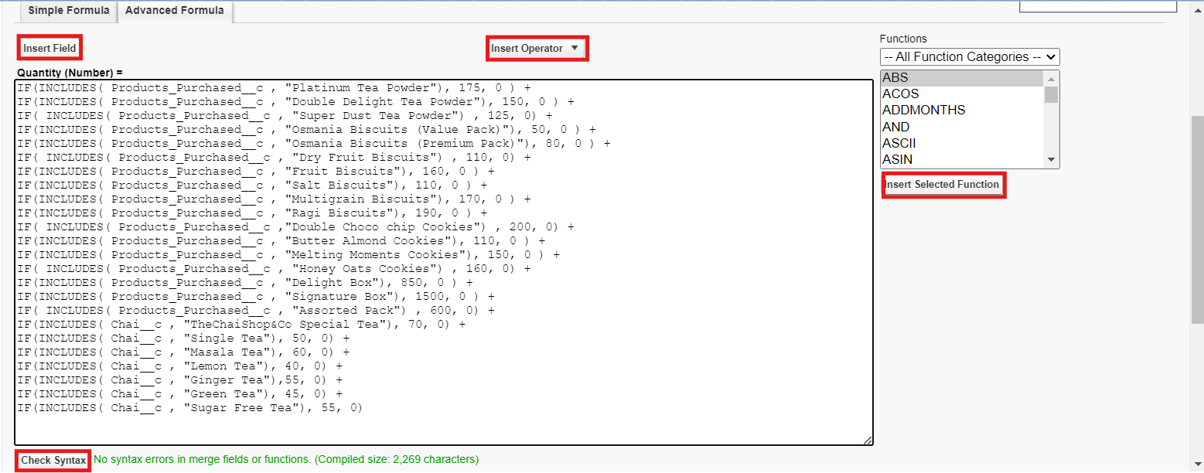
IF(INCLUDES( Chai c , "Sugar Free Tea"), 55, 0)
Click on Next → Next → Save.
Activity 3: Create Custom fields for Enterprise Account
Data Type : Text
Field Label: Enterprise Name
Field Name : Auto Populates Length : 25
Required : Check the box
Click on Next → Next → Save and new.
Data Type : Phone
Field Label : Phone Number Field Name : Auto Populates Required : Check the box
Click on Next → Next → Save and new.
Data Type : Email Field Label : Email ID
Field Name : Auto Populates Required : Check the box
Click on Next → Next → Save and new.
Date Type : Text Field Label : Address
Field Name : Auto Populates

Slide 37
Length : 125
Click on Next → Next → Save and new.
Date Type : Multi Select Picklist
Field Label : Type of Items
Values : Use Global Picklist value set and select Type of Items from the dropdown menu. Field Name : Auto Populates.
Required : Check the box
Click on Next → Next → Save and new.
Date Type : Multi Select Picklist
Field Label : Products purchased
Values : Use Global Picklist value set and select Items from the dropdown menu.
Field Name : Auto Populates. Required : Check the box
Click on Next → Next → Save and new.
Data Type : Lookup Relationship Related To : Employer Account Field Label : Associated Employer Field Name : Auto Populates
Click on Next → Next → Save and new.
Data Type : Formula
Field Label : Order Quantity
Field Name : Auto Populates Formula Return : Number
Enter Formula = Quantity (Number) =
IF(INCLUDES( Products_Purchased c , "Platinum Tea Powder"), 1, 0 ) +
IF(INCLUDES( Products_Purchased c , "Double Delight Tea Powder"), 1, 0 ) + IF( INCLUDES( Products_Purchased c , "Super Dust Tea Powder") , 1, 0) +
IF(INCLUDES( Products_Purchased c , "Osmania Biscuits (Value Pack)"), 1, 0 ) + IF(INCLUDES( Products_Purchased c , "Osmania Biscuits (Premium Pack)"), 1, 0 ) + IF( INCLUDES( Products_Purchased c , "Dry Fruit Biscuits") , 1, 0) +
IF(INCLUDES( Products_Purchased c , "Fruit Biscuits"), 1, 0 ) + IF(INCLUDES( Products_Purchased c , "Salt Biscuits"), 1, 0 ) + IF(INCLUDES( Products_Purchased c , "Multigrain Biscuits"), 1, 0 ) + IF(INCLUDES( Products_Purchased c , "Ragi Biscuits"), 1, 0 ) +
IF( INCLUDES( Products_Purchased c ,"Double Choco chip Cookies") , 1, 0) + IF(INCLUDES( Products_Purchased c , "Butter Almond Cookies"), 1, 0 ) + IF(INCLUDES( Products_Purchased c , "Melting Moments Cookies"), 1, 0 ) + IF( INCLUDES( Products_Purchased c , "Honey Oats Cookies") , 1, 0) + IF(INCLUDES( Products_Purchased c , "Delight Box"), 1, 0 ) +

Slide 38
IF(INCLUDES( Products_Purchased c , "Signature Box"), 1, 0 ) + IF( INCLUDES( Products_Purchased c , "Assorted Pack") , 1, 0)
Click on Next → Next → Save and new.
Data Type : Formula
Field Label : Total Bill
Field Name : Auto Populates Formula Return : Number
Enter Formula = Quantity (Number) =
IF(INCLUDES( Products_Purchased c , "Platinum Tea Powder"), 175, 0 ) + IF(INCLUDES( Products_Purchased c , "Double Delight Tea Powder"), 150, 0 ) + IF( INCLUDES( Products_Purchased c , "Super Dust Tea Powder") , 125, 0) + IF(INCLUDES( Products_Purchased c , "Osmania Biscuits (Value Pack)"), 50, 0 ) +
IF(INCLUDES( Products_Purchased c , "Osmania Biscuits (Premium Pack)"), 80, 0 ) + IF( INCLUDES( Products_Purchased c , "Dry Fruit Biscuits") , 110, 0) + IF(INCLUDES( Products_Purchased c , "Fruit Biscuits"), 160, 0 ) +
IF(INCLUDES( Products_Purchased c , "Salt Biscuits"), 110, 0 ) + IF(INCLUDES( Products_Purchased c , "Multigrain Biscuits"), 170, 0 ) + IF(INCLUDES( Products_Purchased c , "Ragi Biscuits"), 190, 0 ) +
IF( INCLUDES( Products_Purchased c ,"Double Choco chip Cookies") , 200, 0) + IF(INCLUDES( Products_Purchased c , "Butter Almond Cookies"), 110, 0 ) + IF(INCLUDES( Products_Purchased c , "Melting Moments Cookies"), 150, 0 ) + IF( INCLUDES( Products_Purchased c , "Honey Oats Cookies") , 160, 0) + IF(INCLUDES( Products_Purchased c , "Delight Box"), 850, 0 ) +
IF(INCLUDES( Products_Purchased c , "Signature Box"), 1500, 0 ) + IF( INCLUDES( Products_Purchased c , "Assorted Pack") , 600, 0)
Data Type : Picklist
Field Label : Payment Mode
Values : Use Global Picklist value set and select Payment Mode from the dropdown menu. Field Name : Auto Populates.
Required : Check the box
Click on Next → Next → Save.
Milestone 7 : Page Layouts
For the personalized field view in Customer Accounts, let's create two page layouts Online orders and Walk-In orders.
Activity 1: Online Orders page layout
Go to the setup page → click on object manager → From drop down click edit for
Customer Account object.
Click on the Page Layouts → click New.

Slide 39
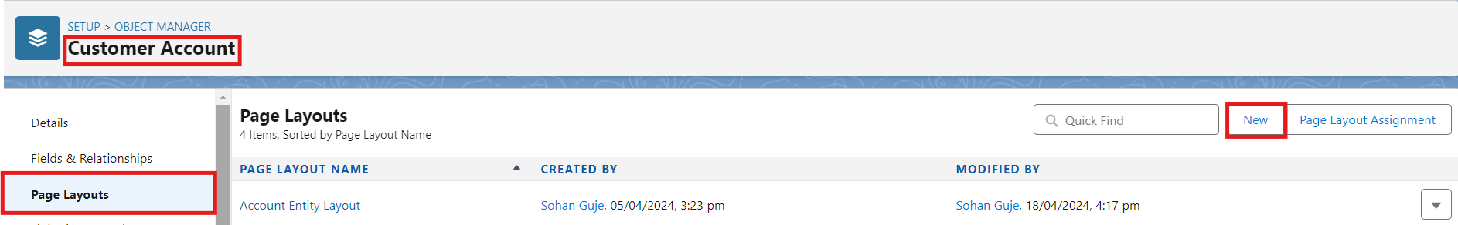
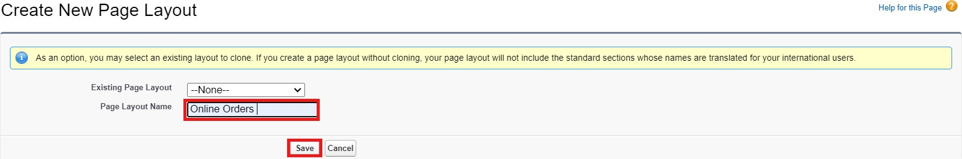
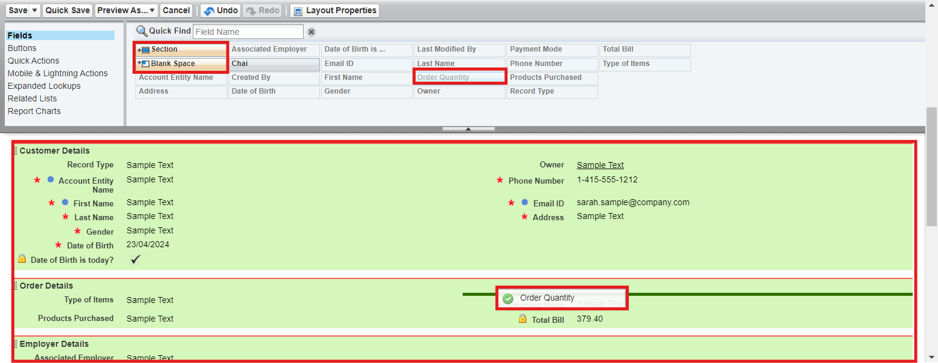
3. Page Layout Name : Online Orders and click Save.
4. Drag and Arrange all the required fields as shown below.
5. Click Save.
Activity 2: Walk-In Orders page layout
Go to the setup page → click on object manager → From drop down click edit for
Customer Account object.
Click on the Page Layouts → click New.
Page Layout Name : Walk-In orders and click save.

Slide 40
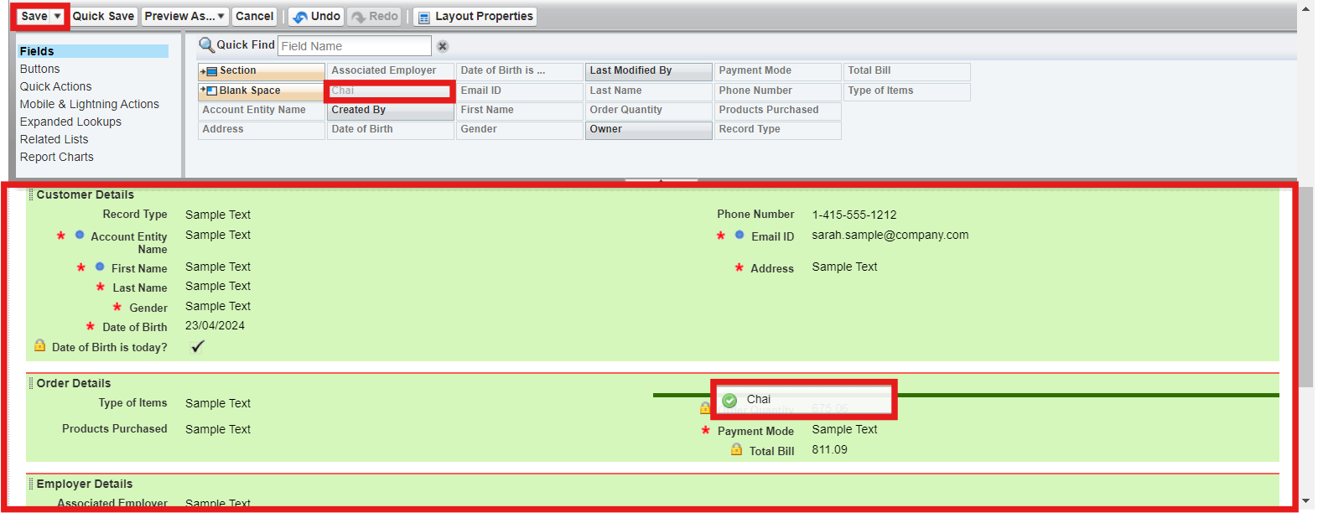
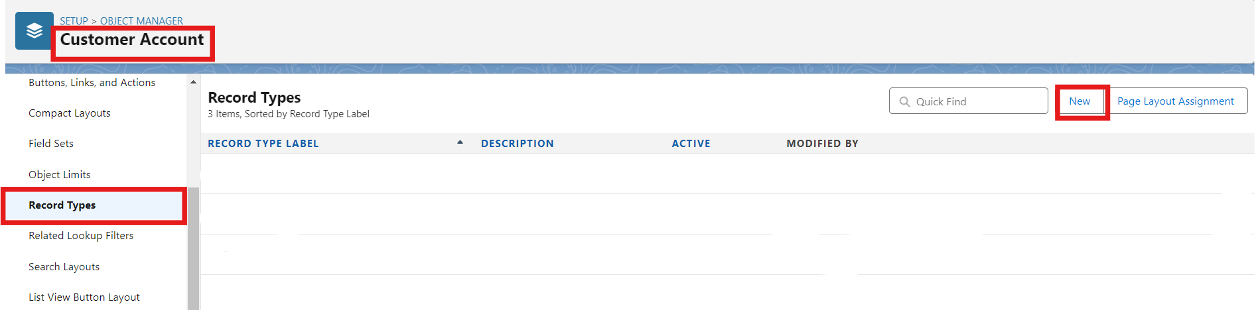
4. Drag and Arrange all the required fields as shown below.
5. Click Save.
Milestone 8 - Record Types
To Differentiate the records and data stored in Customer Accounts, let's create two different Record Types.
Online orders and Walk-In orders.
Activity 1: Online Orders Record Type
Go to the setup page → click on object manager → From drop down click edit for
Customer Account object.
Click on the Record Types → click New.
3. Enter Details :
Existing Record Type : Master Record Type Label : Online Order

Slide 41
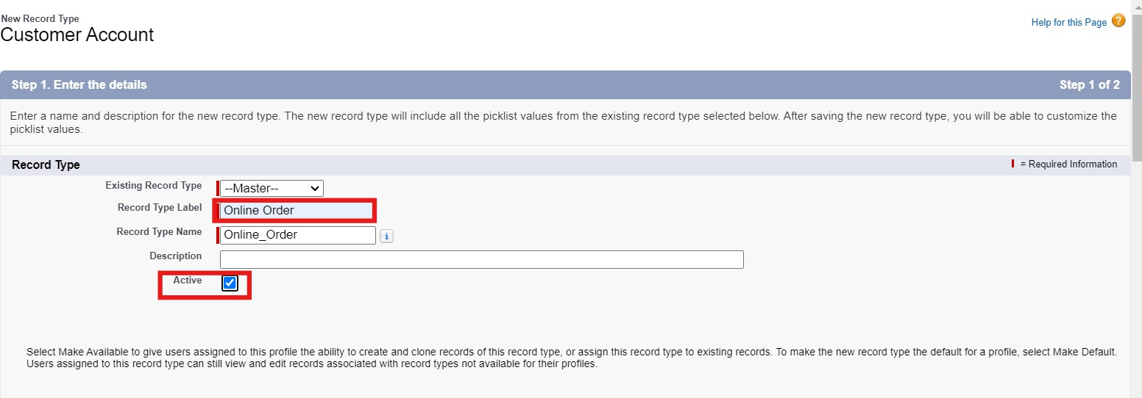
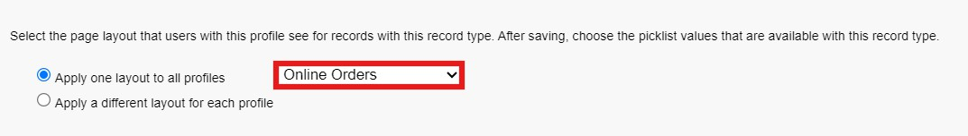
Record Type Name : Auto Populates Active : Tick the checkbox
Click Next
In Assign Page Layouts
  Select Apply one layout to all profiles : select Online orders from the drop down menu.
5. Click Save and New.
Activity 2: Walk-In Orders Record Type
Go to the setup page → click on object manager → From drop down click edit for
Customer Account object.
Click on the Record Types → click New.
Enter Details :
Existing Record Type : Master Record Type Label : Walk-In Order Record Type Name : Auto Populates Active : Tick the checkbox
Click Next
In Assign Page Layouts

Slide 42
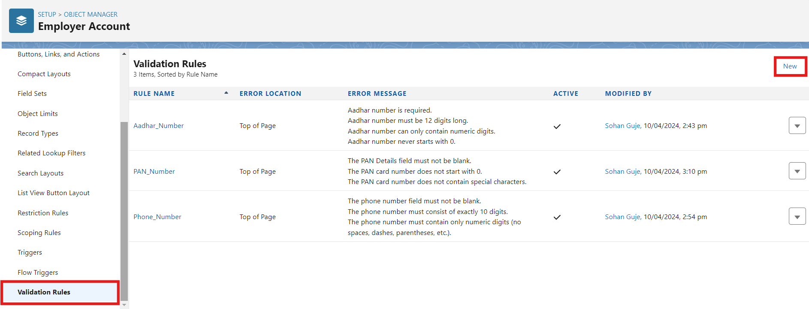
Select Apply one layout to all profiles : select Walk-In orders from the drop down menu.
5. Click Save.
Milestone 9 - Validation Rules Activity 1: On Employer Account
Go to the setup page → click on object manager → From drop down click edit for
Employer Account object.
Click on the validation rule → click New.
3. Enter Rule Name : Aadhar Number
Error Condition Formula :
AND(
NOT(ISBLANK( Aadhar_Number c )), LEN( Aadhar_Number c ) <> 12,
NOT(REGEX( Aadhar_Number c , "^[1-9]{12}$"))
)

Slide 43
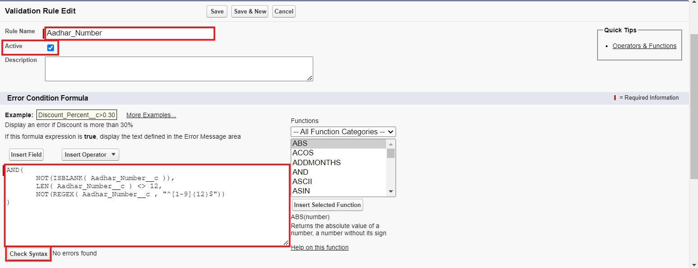
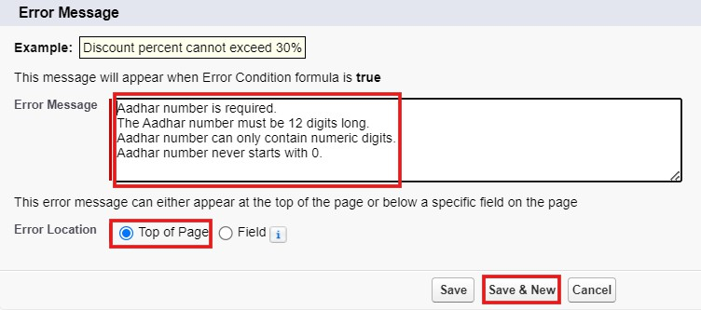
Error Message : Aadhar number is required.
The Aadhar number must be 12 digits long. Aadhar number can only contain numeric digits. Aadhar number never starts with 0
Click Save & New.
Repeat the same steps and create two more validation rules on the employer account object.
  Enter Rule Name : PAN Number
Error Condition Formula :
AND(
NOT(ISBLANK( Phone_Number c )), NOT(REGEX( Phone_Number c , "^[1-9]{10}$")),

Slide 44
NOT(REGEX( Phone_Number c , "^\\d+$"))
)
Error Message : The PAN Details field must not be blank.
The PAN card number does not start with 0.
The PAN card number does not contain special characters.
Click Save & New.
Enter Rule Name : Phone Number
Error Condition Formula :
AND(
NOT(ISBLANK( Phone_Number c )), NOT(REGEX( Phone_Number c , "^[1-9]{10}$")), NOT(REGEX( Phone_Number c , "^\\d+$"))
)
Error Message :
The phone number field must not be blank.
The phone number must consist of exactly 10 digits. The phone number must contain only numeric digits (no spaces, dashes, parentheses, etc.)
Click Save.
Activity 2: On Customer Account
Go to the setup page → click on object manager → From drop down click edit for
Customer Account object.
Click on the validation rule → click New.
Enter Rule Name : Phone Number
Error Condition Formula :
AND(
NOT(ISBLANK( Phone_Number c )), NOT(REGEX( Phone_Number c , "^[1-9]{10}$")), NOT(REGEX( Phone_Number c , "^\\d+$"))
)
Error Message :
The phone number field must not be blank.

Slide 45
The phone number must consist of exactly 10 digits. The phone number must contain only numeric digits (no spaces, dashes, parentheses, etc.)
4. Click Save.
Activity 3: On Enterprise Account
Go to the setup page → click on object manager → From drop down click edit for
Customer Account object.
Click on the validation rule → click New.
Enter Rule Name : Phone Number
Error Condition Formula :
AND(
NOT(ISBLANK( Phone_Number c )), NOT(REGEX( Phone_Number c , "^[1-9]{10}$")), NOT(REGEX( Phone_Number c , "^\\d+$"))
)
Error Message :
The phone number field must not be blank.
The phone number must consist of exactly 10 digits. The phone number must contain only numeric digits (no spaces, dashes, parentheses, etc.)
Click Save.
Milestone 10 - Email Template
Activity 1: Email Template
Go to setup, In quick find box enter Email template → click on classic Email Template.
Click on→ New Email Template
Choose the type of email template you would like to create : Text and click Next.

Slide 46
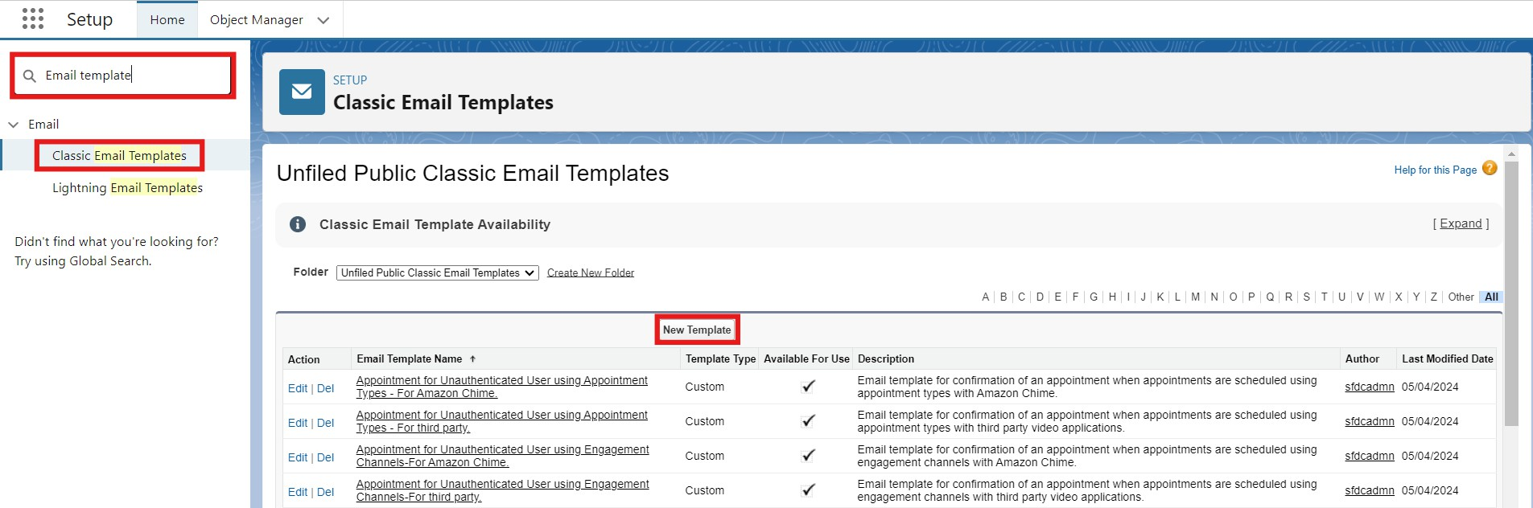
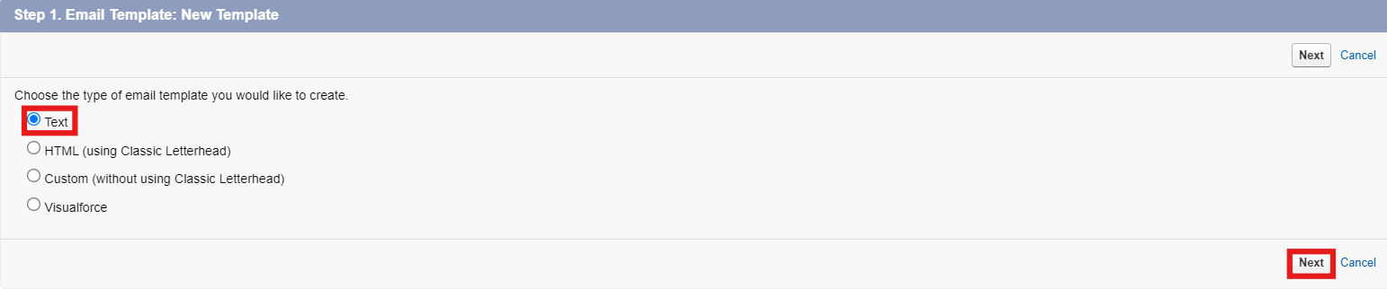
Available Merge Fields
Select Field Type : Customer Accounts Fields
Select Field : First Name
Copy Merge Field value : Auto Populates, Copy the value and paste it in the email body where required.
Folder : Unfiled public Classic Email templates
Click on available for use
Email Template Name is “Birthday Offer Email”
Template Unique Name : Auto populated
Subject : Special Birthday Offer Inside!
Email body :
Dear {!Customer_Account c.First_Name c},
Happy Birthday from all of us at TheChaiShop&Co! 🎉🎂 We hope your special day is filled with joy, laughter, and wonderful memories.
To celebrate your birthday, we have a special gift just for you! As a token of our appreciation for your continued support, we're delighted to offer you an exclusive birthday discount.
🎁 Birthday Offer: Enjoy a fantastic 50% off on your next purchase as our birthday gift to you!

Slide 47
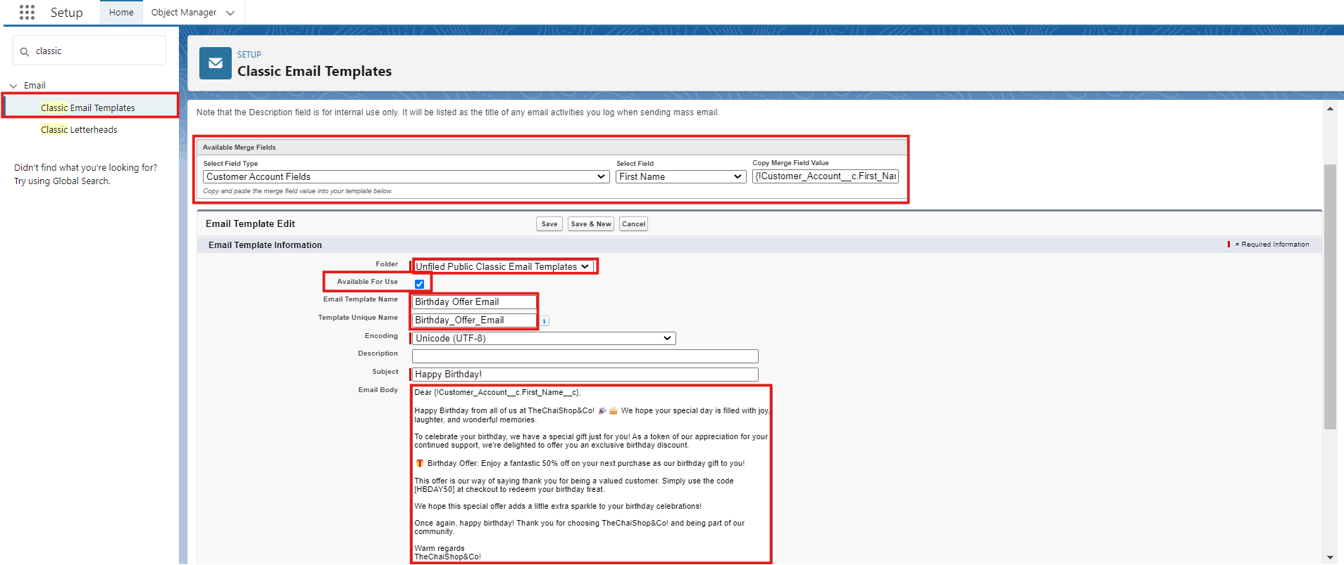
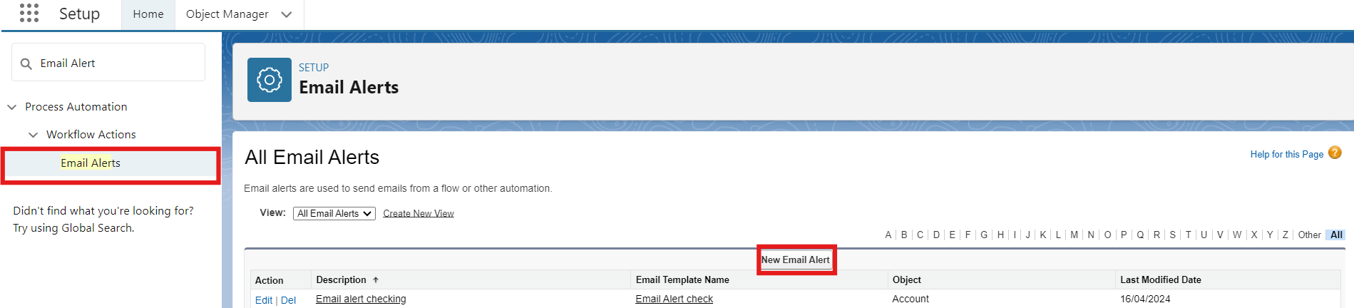
This offer is our way of saying thank you for being a valued customer. Simply use the code [HBDAY50] at checkout to redeem your birthday treat.
We hope this special offer adds a little extra sparkle to your birthday celebrations!
Once again, happy birthday! Thank you for choosing TheChaiShop&Co! and being part of our community.
Warm regards TheChaiShop&Co!
10. Click Save.
Activity 2: Email Alert
1. Go to setup, In quick find box enter Email Alert → click on Email Alert .
Click on New Email Alert.
Description : Happy Birthday email alert
Unique Name : Auto Populates

Slide 48
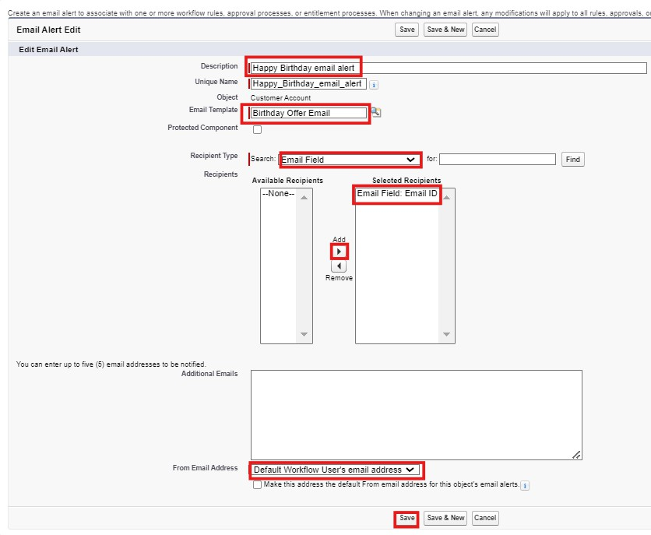
Object : Customer Account
Email Template : Search for Birthday Offer Email Recipient Type : Search : Email field : Email ID
From Email Address : Default Workflow user’s email address Click Save.
NOTE :
1. Make sure that the Default workflow user is assigned.

Slide 49
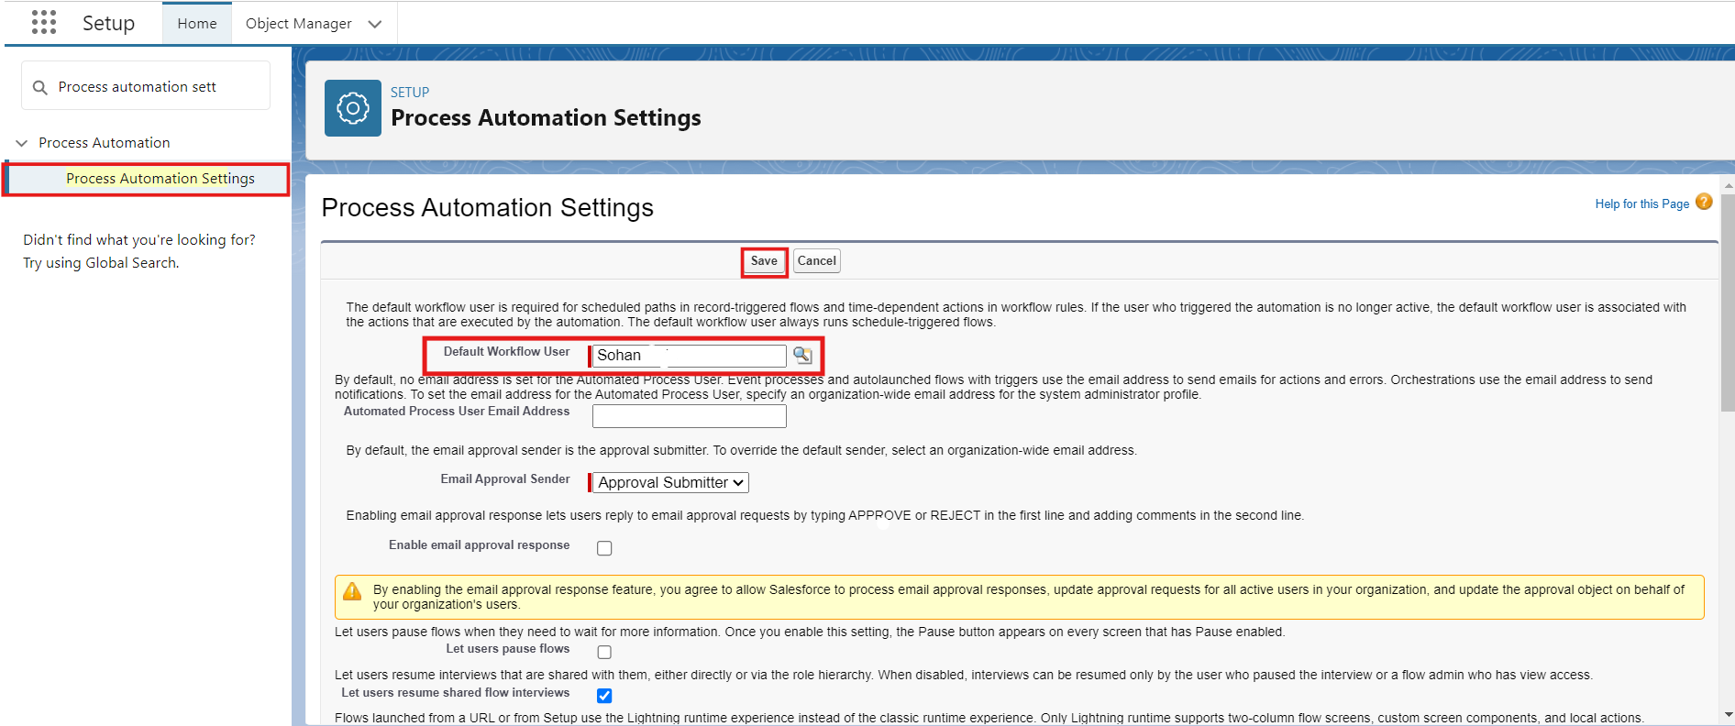
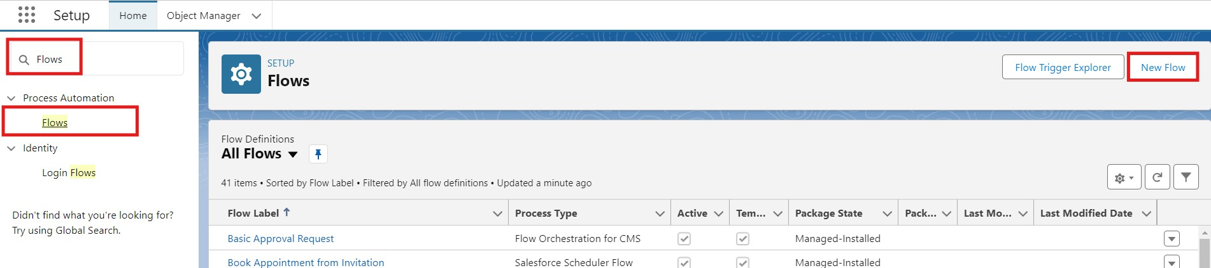
Milestone 11 - Flows
Let’s create a scheduled Triggered flow to automate the Birthday offer mails.
Activity 1: Schedule Triggered Flow
1. Go to setup, Type Flow in quick find box → Click on the Flow and Select the New Flow.
2. Select Schedule - Triggered Flow and click Create.

Slide 50
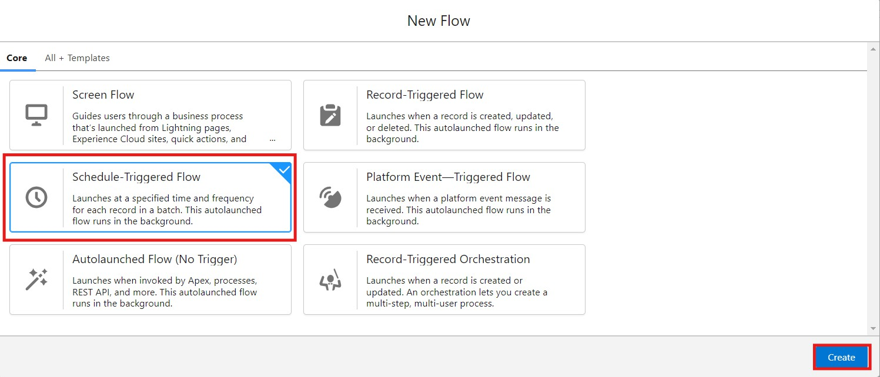
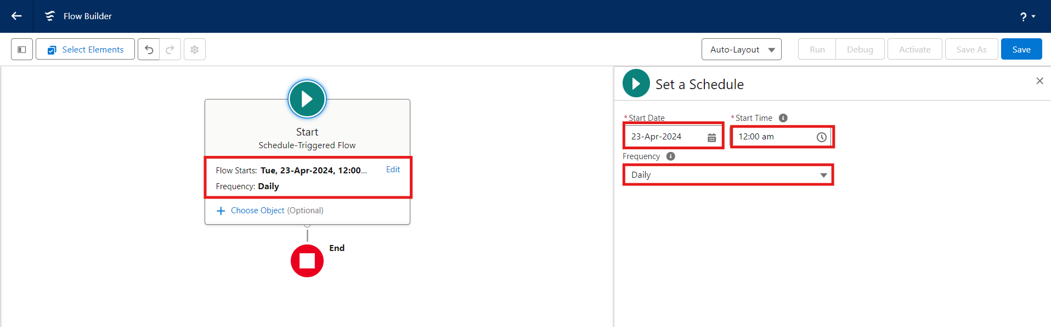
3. Set a Schedule
Start Date : Enter the Date, when you want to start the flow. Start Time : Enter the Time, when you want to start the flow. Frequency : Daily
Create Object
Object : Customer Account
Condition Requirements : All conditions Are Met (AND)
  Field : Date_of_Birthday_is_today c Operator : Equals
Value : $GlobalConstant.True
  Field : Email_ID_c Operator : IS NULL
Value : $GlobalConstant.False

Slide 51



5. Click (+) Icon on the flow builder and Select Action Component.
6. In New Action Page
Filter By : Type and select Email Alert
In Action : Search and select Happy Birthday email alert
Label : Send Happy Birthday Email
API Name : Auto Populates
Set Input Values for the Selected Action : Record ID : {!$Record.Id}

Slide 52



Click Done.
Click Save on the top right
Flow Label : Happy Birthday Email Flow Flow API Name : Auto Populates
Click Save.

Slide 53



9. Click Activate.
Milestone 12 - Reports & Dashboards
Activity 1: Customer Account Sales Report
Click App Launcher
Click Reports
Click New Report
and select TheChaiShop&Co.

Slide 54



In search type Customer Accounts and Select Customer Accounts.
Click Start Report.
Click the toggle Update Preview Automatically to ON.
Drag and Drop all the required Columns from the Outline pane.
Group Rows : Search and Select
Customer Account: Record Type
Click Add Chart on the top.

Slide 55


10. Click Save on the top right. Enter
Report Name: Customer Account Sales Report Report Unique Name : Auto Populates
Click Save.
Activity 2: Enterprise Account Sales Report
Repeat the same steps to create another report.
Click Reports
Click New Report
In search type Enterprise Accounts and Select Enterprise Accounts.
Click Start Report.
Click the toggle Update Preview Automatically to ON.
Drag and Drop all the required Columns from the Outline pane.

Slide 56



Group Rows : Search and Select
Type of Items.
7. Click Add Chart on the top.
Click Save on the top right.
  Enter
  Report Name : Enterprise Account Sales Report
  Report Unique Name : Auto Populates
  Click Save.
Activity 3: Dashboard
Click Dashboards
Click New Dashboards

Slide 57



Name : Customer Vs Enterprise Sales
Click Create.
Click Widget
Select Chart or Table.
7. Select Customer Account Sales Report

Slide 58


Display As : Select the one which you feel comfortable with.
Click Add.
Repeat the same steps for the Enterprise Account Sales Report.
Click Save.

Slide 59
Milestone 12 - Conclusion
In conclusion, the development of TheChaiShop&Co CRM application marks a significant stride in enhancing the store's operational efficiency and customer relationship management capabilities. Seamlessly integrating employer details, customer information (both online and offline), and enterprise data, this application streamlines business processes and enables informed decision-making. The automation of sales calculations, including order quantity and total bill amount, reduces errors and empowers employees to focus on delivering exceptional service. Moreover, automated email notifications for customers' birthdays foster personalized communication and enhance customer engagement.
FUNCTIONAL & PERFORMANCE TESTING
During the testing phase, screenshots were captured from the Salesforce Lightning interface to verify correct system behavior. These include:
  Record creation for Employer, Customer, and Enterprise objects
  Validation rule testing for Aadhar, PAN, and phone numbers
  Verification of record types and page layouts
  Formula field validation for order quantity and billing
  Flow execution for birthday email alerts
  Report and dashboard generation
Performance testing ensured fast response time and system stability during concurrent usage.
ADVANTAGES & DISADVANTAGES
Advantages
  Centralized data management

Slide 60
Reduced manual work
Automated calculations
Improved customer engagement
Real-time analytics
Disadvantages
Requires Salesforce license
Internet dependency
Limited offline access
9. Conclusion:
The CRM Application for TheChaiShop&Co successfully improves business operations by integrating customer data, automating billing, and enabling intelligent reporting. The system reduces errors, saves time, and enhances customer relationships through automation and analytics.
FUTURE SCOPE
  Mobile CRM integration
  AI-based sales prediction
  WhatsApp/SMS alerts
  Inventory management
  Multi-branch support
  Advanced customer profiling

Slide 61
11. APPENDIX
Source Code : Salesforce Configuration & Flows
Dataset : Customer and Sales Records
Tools Used : Salesforce Developer Org
Thank You

